Slide 1


Multiomics analysis of the gene expression and epigenetic dynamics across cardiac differentiation with variational autoencoders
Mario Esposito
Internal supervisor
Prof. Castrense Savojardo
External supervisors
Enrique Blanco and Luciano Di Croce
(CRG, Barcelona)
Department of Pharmacy and Biotechnology
Second cycle degree in Bioinformatics
Graduation Session III / December 12th, 2024
Academic Year 2023/2024

Slide 2
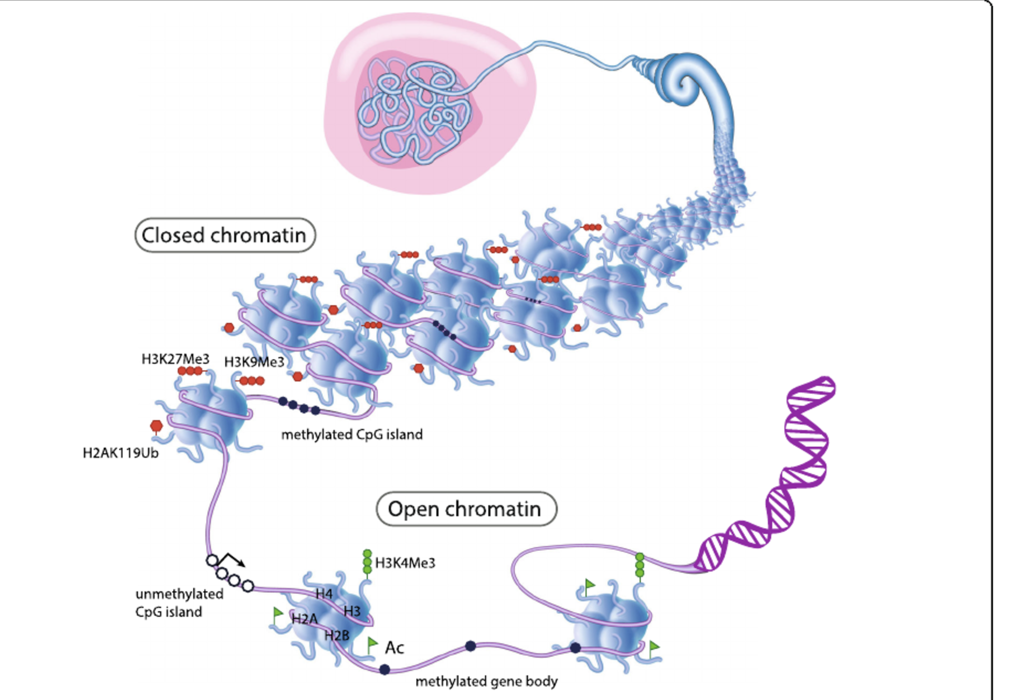
Chromatin Dynamics and Gene Regulation
From Holliday et al., 2018
Histone posttranslational modifications (PTMs), DNA methylation and chromatin remodeling factors contribute to the regulation of gene expression through intricate mechanisms that influence the chromatin state
Chromatin is dynamic rather than static and its state transitions are essential during cellular processes (e.g., development and disease)
Notes:
In eukaryotes, DNA is compacted within the nucleus. This is achieved through its organization into chromatin, where DNA is wrapped around histone proteins.
Histone posttranslational modifications, DNA methylation, and chromatin remodeling factors contribute to the regulation of gene expression through complex mechanisms that influence the chromatin state.
Chromatin is dynamic and transitions between states play a crucial role in cellular processes such as, development,

Slide 3
Increment of omics datasets demand efficient processing
www.ncbi.nlm.nih.gov/sra/docs/sragrowth/
Over the past decades, advances in high-throughput sequencing have driven exponential growth in data generation
The rapid growth of omics datasets demands efficient computational processing
Notes:
Over the past decades, advances in high-throughput sequencing technologies have driven exponential growth in data generation. As shown in the plot, this growth is evident in the increasing size of the Sequence Read Archive (SRA) database. However, given this rapid expansion, there is a pressing need for computational methods that are efficient in extracting meaningful insights from these vast datasets."

Slide 4
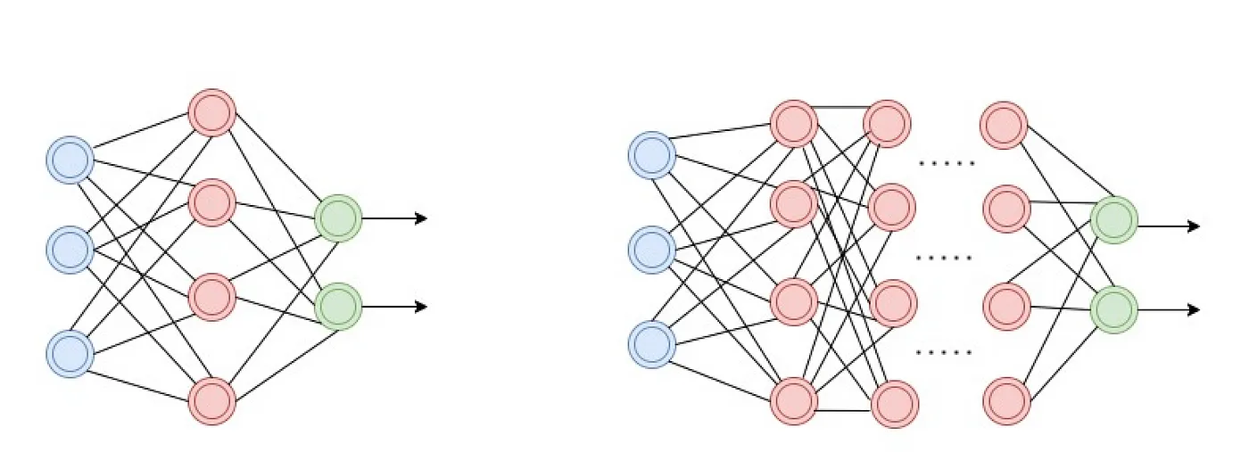
Deep learning (DL) has been successfully applied to omics datasets
Artificial Neural Networks (ANNs)
Shallow
Deep
Multiple hidden layers
Adapted from Valdivino Santiago (Towards data science)
Deep learning (DL) is a general term for machine-learning algorithms that are made up of deep neural networks (DNNs)
Notes:
Deep learning (DL) models have been successfully applied to omics datasets
"Deep learning, involves neural networks with multiple hidden layers that can learn complex features relationships from large datasets.

Slide 5
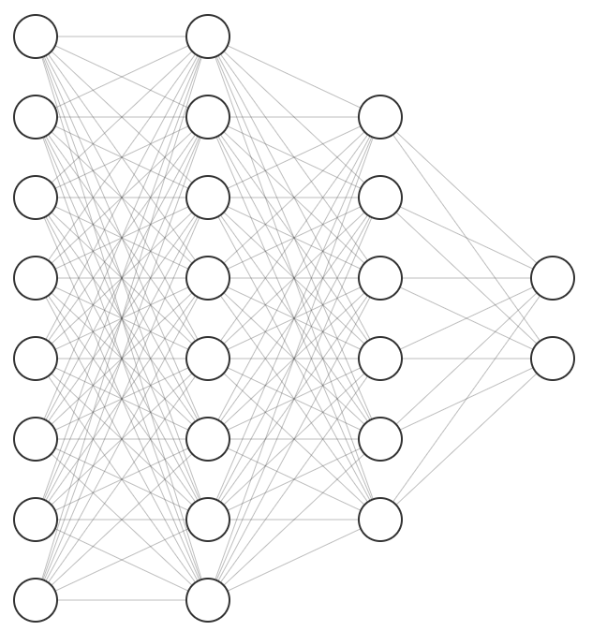
Autoencoders (AEs) learn a compressed representation of the input
Clustering
Latent
Representation
Input
Reconstruction
Latent
space
Encoder
Decoder
Loss = Reconstruction error
Neural network architecture designed to firstly efficiently compress (encode) input data into a latent representation, and, then reconstruct (decode) the original input from the latent representation
Representation learning and Dimensionality reduction
Notes:
When data labeles are not availabel, self-supervised learning provides a promising alternative. This approach leverages the structure within the data itself to generate pseudo-labels, allowing the model to learn meaningful representations without requiring explicit manual labeling.
Autoencoders are an example of this approach. AEs are designed to firstly efficiently compress (encode) input data into a latent representation, and, then reconstruct (decode) the original input from the latent representation
The primary goal of autoencoders is not just reconstruction but to enable dim reduction representation learning that can be used for downstream tasks such as clustering

Slide 6
Variational-AEs (VAEs) are the probabilistic extension of AEs
mean
sampling
Input
std. dev.
Reconstruction
Encoder
Latent
space
Decoder
Loss = Reconstruction error + Kullback–Leibler Divergence
VAEs encode each data point as a continuous distribution in the latent space (e.g., Gaussian)
This allows for both representation learning and the generation of new instances by sampling from the latent distribution
Notes:
Autoencoders exist in various forms, with the Variational Autoencoder (VAE) VAEs represent a probabilistic extension of traditional autoencoders. The key difference lies in how they encode data: instead of mapping input data to specific points in the latent space, VAEs encode the data as a continuous probability distribution within the latent space. By sampling from this distribution, VAEs model data variability during training and after training also enables to generate new data points that resemble the training data,

Slide 7
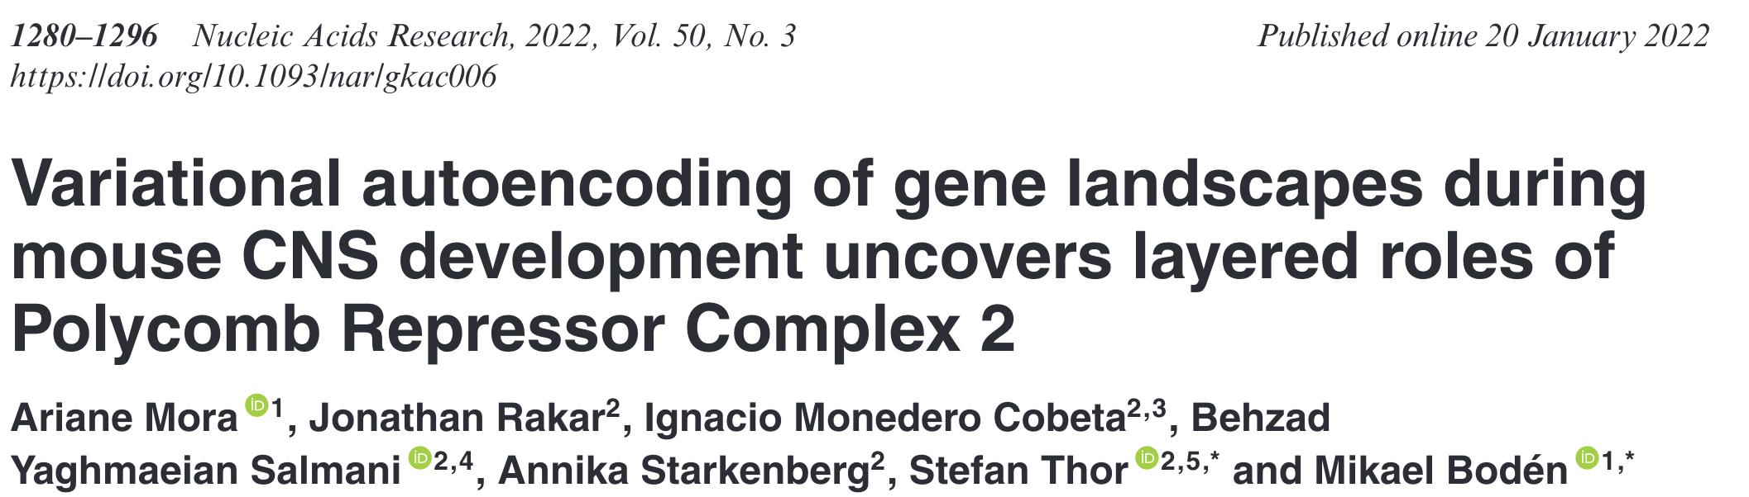
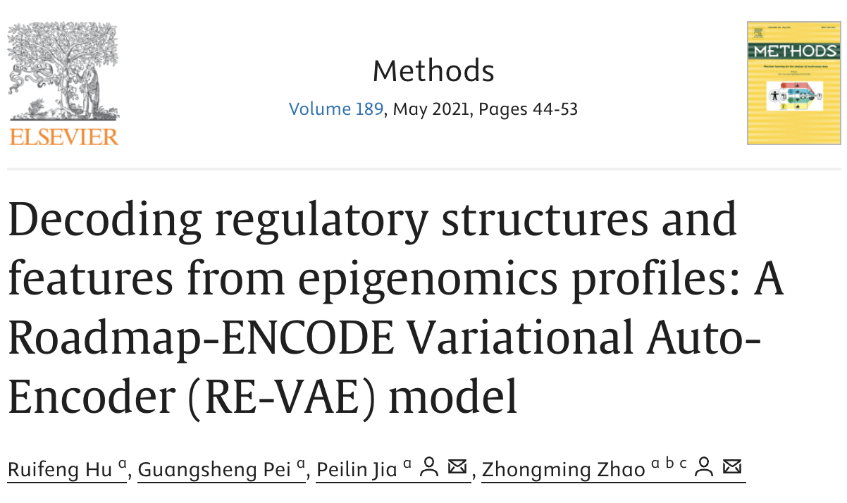

Examples of VAEs applications in epigenomics
multi-omics data integration to study gene regulation across time, tissues, and conditions
DNA methylation data from lung cancer samples
ChIP-seq signals from promoter and enhancer regions
Notes:
This slide shows examples of articles where Variational Autoencoders (VAEs) have been implemented on epigenomics data.
These studies demonstrated the ability of this architecture to extract, biologically, relevant epigenomic representation in different context.

Slide 8
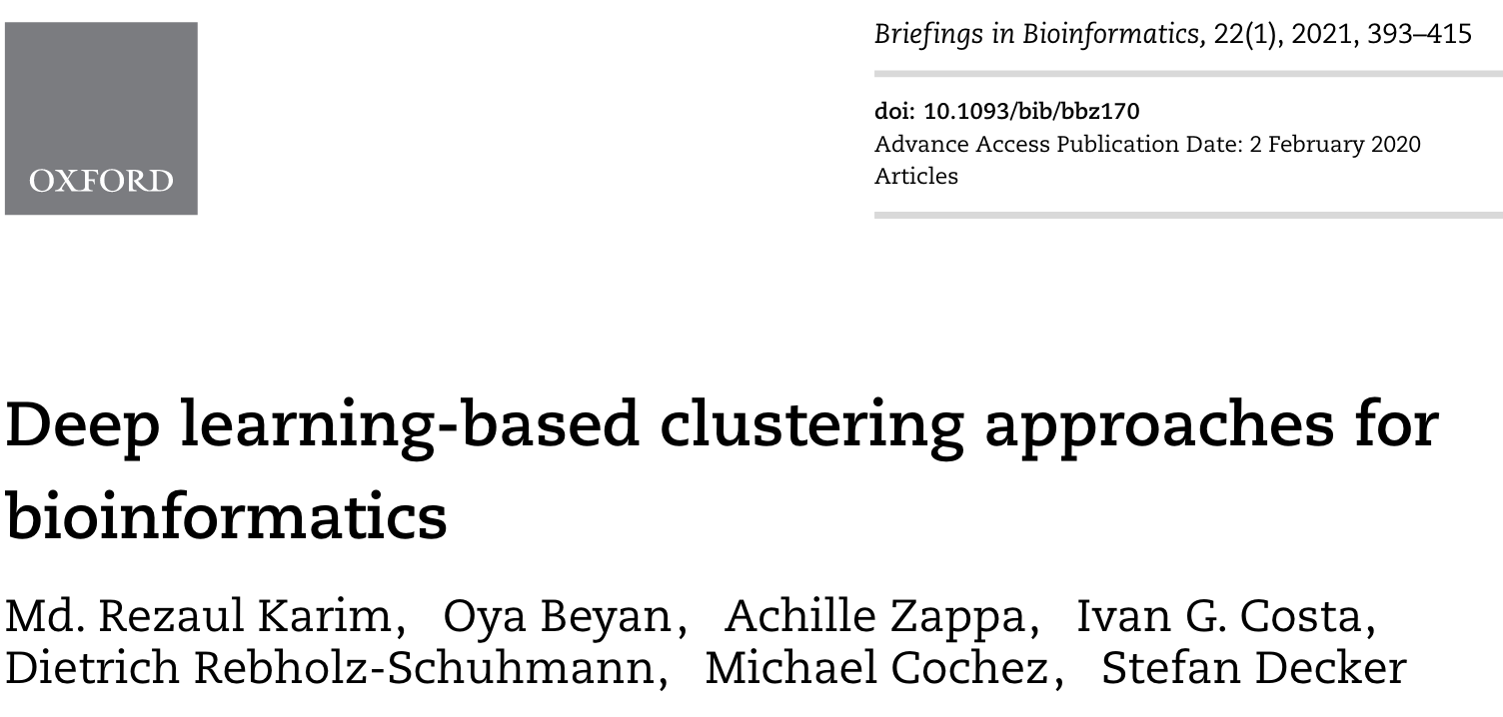

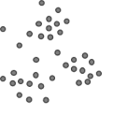
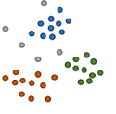
Clustering can be facilitated by the representation learned by DL
Latent representation
Clustering
Input
Encoder deep neural network
Learning non-linear mappings can transform input data into more clustering-friendly representations
Also, DL models learning allow to integrate different data types into a single common representation on which apply clustering
Notes:
Clustering algorithms can be facilitated from the representations learned by DL models. Additionally, representation learning enables the integration of multiple data types into a single, unified representation. This is particularly valuable in omics studies, where combining diverse dataset, such as transcriptomics and epigenomics, providing a more comprehensive view of biological systems.

Slide 9
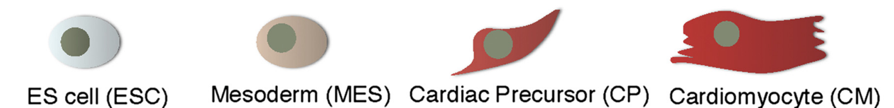
Aims of the project
General project Workflow
Cardiac differentiation
Representation learning
(VAE)
Clustering
Groups of genes
sharing expression and epigenetic dynamics
Dataset
(genes as points)
Compressed Representation
Epigenomics and Transcriptomics data
Challenging VAEs, AEs and other techniques for their ability to compress and reconstruct multi-omics data collected along cardiac differentiation in mouse
To explore the VAE latent space, searching for novel expression and epigenetic patterns captured by the model
Notes:
The aims of the project were: to test VAEs, AEs and other techniques for their ability to compress and reconstruct multi-omics data collected along cardiac differentiation in mouse
To explore expression and epigenetic dynamics patterns captured by the model, by clustering genes based on their VAE representation

Slide 10
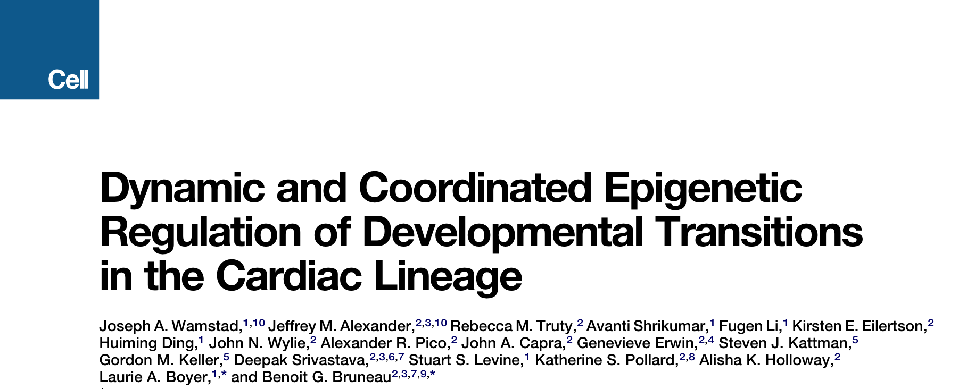
Transcriptomic and epigenomic data collected during cardiac differentiation
Input Data: RNA-seq and ChIP-seq data covering four stages of mouse cardiac differentiation and multiple histone PTMs, from Wamstad et al. 2012.
RNA-seq
ChIP-seq
x 2 Replicates
H3K4me3
H3K27ac
H3K27me3
Control
Wamstad et al., 2012
Notes:
To construct our dataset we downloaded public raw data associated with this publication of 2012
RNA-seq data were available in two replicates, in four cardiac differentiation stages in mouse: Embryonic Stem Cells (ESC), Mesoderm (MES), Cardiac Precursors (CP), and Cardiomyocytes (CM). ChIP-seq data were available for the same cell types (CTs), with two or three replicates, targeting three histone posttranslational modifications (HMs): H3K4me3, H3K27me3, H3K27ac and whole cell extract (WCE) as a control.

Slide 11
Transcriptomic and epigenomic data collected during cardiac differentiation
Input Data: RNA-seq and ChIP-seq data covering four stages of mouse cardiac differentiation and multiple histone PTMs, from Wamstad et al. 2012.
RNA-seq
ChIP-seq
x 2 Replicates
H3K4me3
H3K27ac
H3K27me3
Control
activation
repression
Associated with gene

Slide 12
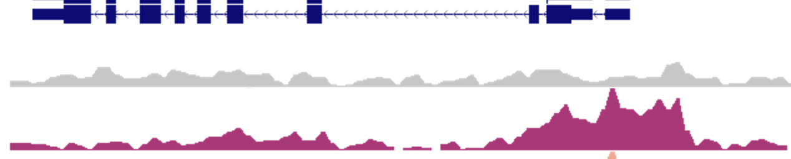
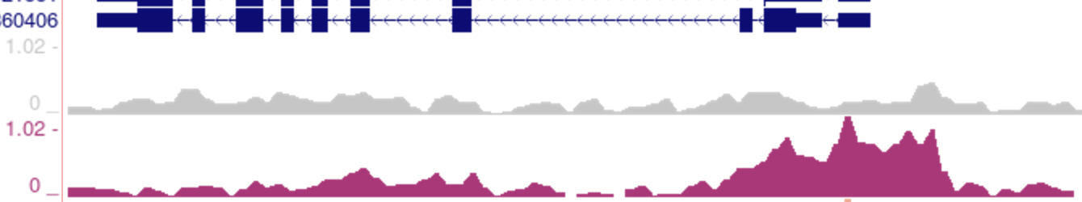
Feature extraction and normalization
Gene expression:
mapping → read count → Fragments Per Kilobase Million (FPKM) → log transformation → Z-score
ChIP-levels:
mapping → read count in promoter region → Sequence depth normalization → log ratio over control → Z-score
Gene
ChIP-seq Control
ChIP-seq Target
-2500 TSS +2500
Notes:
In this slide, I summarize the feature extraction and normalization steps applied to RNA-seq and ChIP-seq data following the alignment of reads to the reference genome. For each gene, the RNA-seq data were processed by first converting raw read counts into Fragments Per Kilobase of transcript per Million mapped reads (FPKM) for normalization. The FPKM values were then log-transformed to address skewness in the data, followed by a Z-score transformation to standardize across samples.
For ChIP-seq data, the analysis focused on read counts within promoter regions. These counts were normalized to account for sequencing depth, and a log ratio relative to control samples was calculated. Finally, the resulting values were standardized using Z-score transformation. This approach ensures comparability and consistency of features across all samples.

Slide 13

Gene filtering criteria
24,919 genes
(UCSC-RefSeq mouse)
✅ Genes having an FPKM >0.5 (avg. across replicates) in at least one cell type (differentiation stage)
❌ Genes intersecting with problematic regions according to ENCODE blacklist v2¹
❌ Small non-coding RNAs and genes mapping on alternative chromosomes
14,996 genes
¹Amemiya et al., 2019
Notes:
This slide outlines the filtering criteria applied to include genes. Genes were retained if their average FPKM exceeded 0.5 in at least one cell type or differentiation stage. Genes overlapping with problematic regions were excluded, as well as small non-coding RNAs and genes mapping to alternative chromosomes.
In the end around 15,000 genes were retained

Slide 14
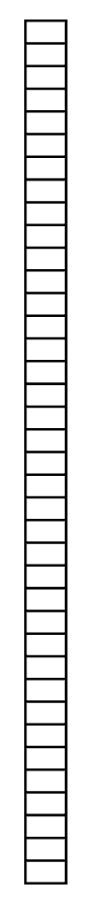
Genes described by features collected along cardiac differentiation
Dataset (14,996 genes x 38 features)
Features: ChIP-levels + Gene expression levels + Expression Log Fold-Changes (logFCs) (24 + 8 + 6 = 38)
Input gene
ChIP-levels
6 Dimensions
RNA FPKMs
RNA logFCs
Dimensionality reduction methods
Variational-AE (VAE)
Autoencoder (AE)
Uniform manifold approximation and projection (UMAP)
Principal component analysis (PCA)
38D
DL-based
Notes:
By concatenating gene expression and ChIP-levels, each gene was represented as a data point, defined by a set of features collected across differentiation.
To obtain a unified representation of the data, we tested several dimensionality reduction techniques, including Variational Autoencoders (VAE), Autoencoders (AE), UMAP, and PCA, to evaluate their ability to compress and reconstruct the data.
Additionally, we incorporated expression log fold changes (logFCs) computed between different time points. This enhancement improved the reconstruction quality

Slide 15
Compare methods by reconstruction performances
Reconstruction metrics:
Root Mean Squared Error
Cosine Similarity
Input gene
Reconstructed gene
6 Dimensions
ChIP-levels
ChIP-levels
RNA FPKMs
RNA FPKMs
RNA logFCs
RNA logFCs
38D
38D
Notes:
To compare the performance of these methods, we adopted two reconstruction metrics, Root Mean Square Error (RMSE) and cosine similarity. These metrics allowed us to evaluate how well each approach compressed and reconstructed the data.

Slide 16
VAE and AE hyperparameters optimization
Random search (VAE and AE): train on training set and optimize reconstruction of validation set
Assess generalization capabilities on testing set (unseen data)
Dataset split
Random Search (500 trials)
Hyperparameter | Search space
Activation function | SELU, ELU, PReLU
Num. activation layers | From 2 to 8
Num. neuron scaling factor | From 1.0 to 2.0
Batch normalization | True, False
Batch size | From 16 to 512
β* | From 1×10⁻⁹ to 1×10⁻¹
80% Training
90%
20% Validation
Testing 10%
Notes:
To optimize the hyperparameters of the deep learning model, the dataset was divided into training, validation, and testing sets. A random search strategy was employed to explore various hyperparameter combinations by training the model on the training set and optimizing reconstruction performance on the validation set. Once the best hyperparameter combination was identified, the models were evaluated on the testing set to assess generalization capabilities and check for overfitting

Slide 17
VAE as best model in compressing and reconstructing data
Comparison made when models are trained and evaluated on the whole data
Average [5th-95th percentiles]
 | Root Mean Squared Error (RMSE) | Cosine similarity (S_{c})
VAE | 0.24 [0.14-0.42] | 0.95 [0.85-0.99]
AE | 0.30 [0.17-0.52] | 0.93 [0.81-0.99]
UMAP | 0.37 [0.19-0.68] | 0.89 [0.7-0.98]
PCA | 0.29 [0.16-0.48] | 0.93 [0.79-0.99]
1st
3rd
4th
2nd
RMSE
Lower is better
Cosine Similarity
Higher is better
****: Wilcoxon’s p < 1e-4
Notes:
We then compared the models by testing their performance when trained and evaluated on the whole dataset
In the table, metrics are reported in terms of averages and percentiles, and the Variational Autoencoder (VAE) emerged as the best-performing model. Interestingly, PCA, which can be considered a baseline method, performed as the second-best, with the Autoencoder (AE) scoring similarly. UMAP showed the lowest performance among the methods tested. The Boxplots show the metrics distribution reveal significant differences when comparing methods with PCA, confirming the ranking.

Slide 18
VAE reconstruction of cell type marker genes
On the rows, four expression marker genes per cell type (differentiation stage) selected based on knowledge in literature
Original values
Reconstructed values
logFCs
logFCs
ESC
Decoder
MES
Cell type markers
6D code
CP
Encoder
CM
Cell type
Feature group
logFC
Z-score
Cell-type-specific (CTS) genes, also known as marker genes, are genes that are highly expressed in one cell type, but lowly expressed in other types (Qiu et al., 2021)
Notes:
To visualize the VAE model’s reconstruction capabilities, we generated heatmaps of the original and reconstructed values for a selected set of genes
We selected Four CT-specific marker genes for each CT based on prior knowledge in literature. In the heataps you can see genes on the rows grouped by CT, and on the column features grouped by HM and expression. Inside each gourp features are ordered by differentiation time points.
Comparing visually these heatmaps, we observed that the model successfully reconstructed the expression and epigenetic patterns for this subset of genes, with only minor differences.

Slide 19
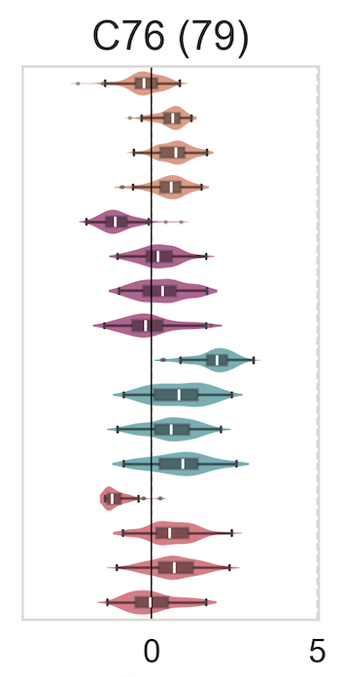
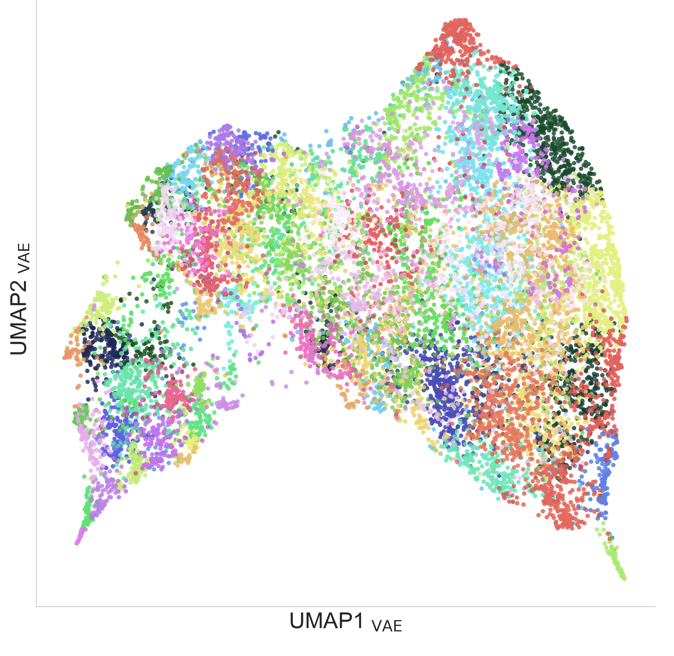
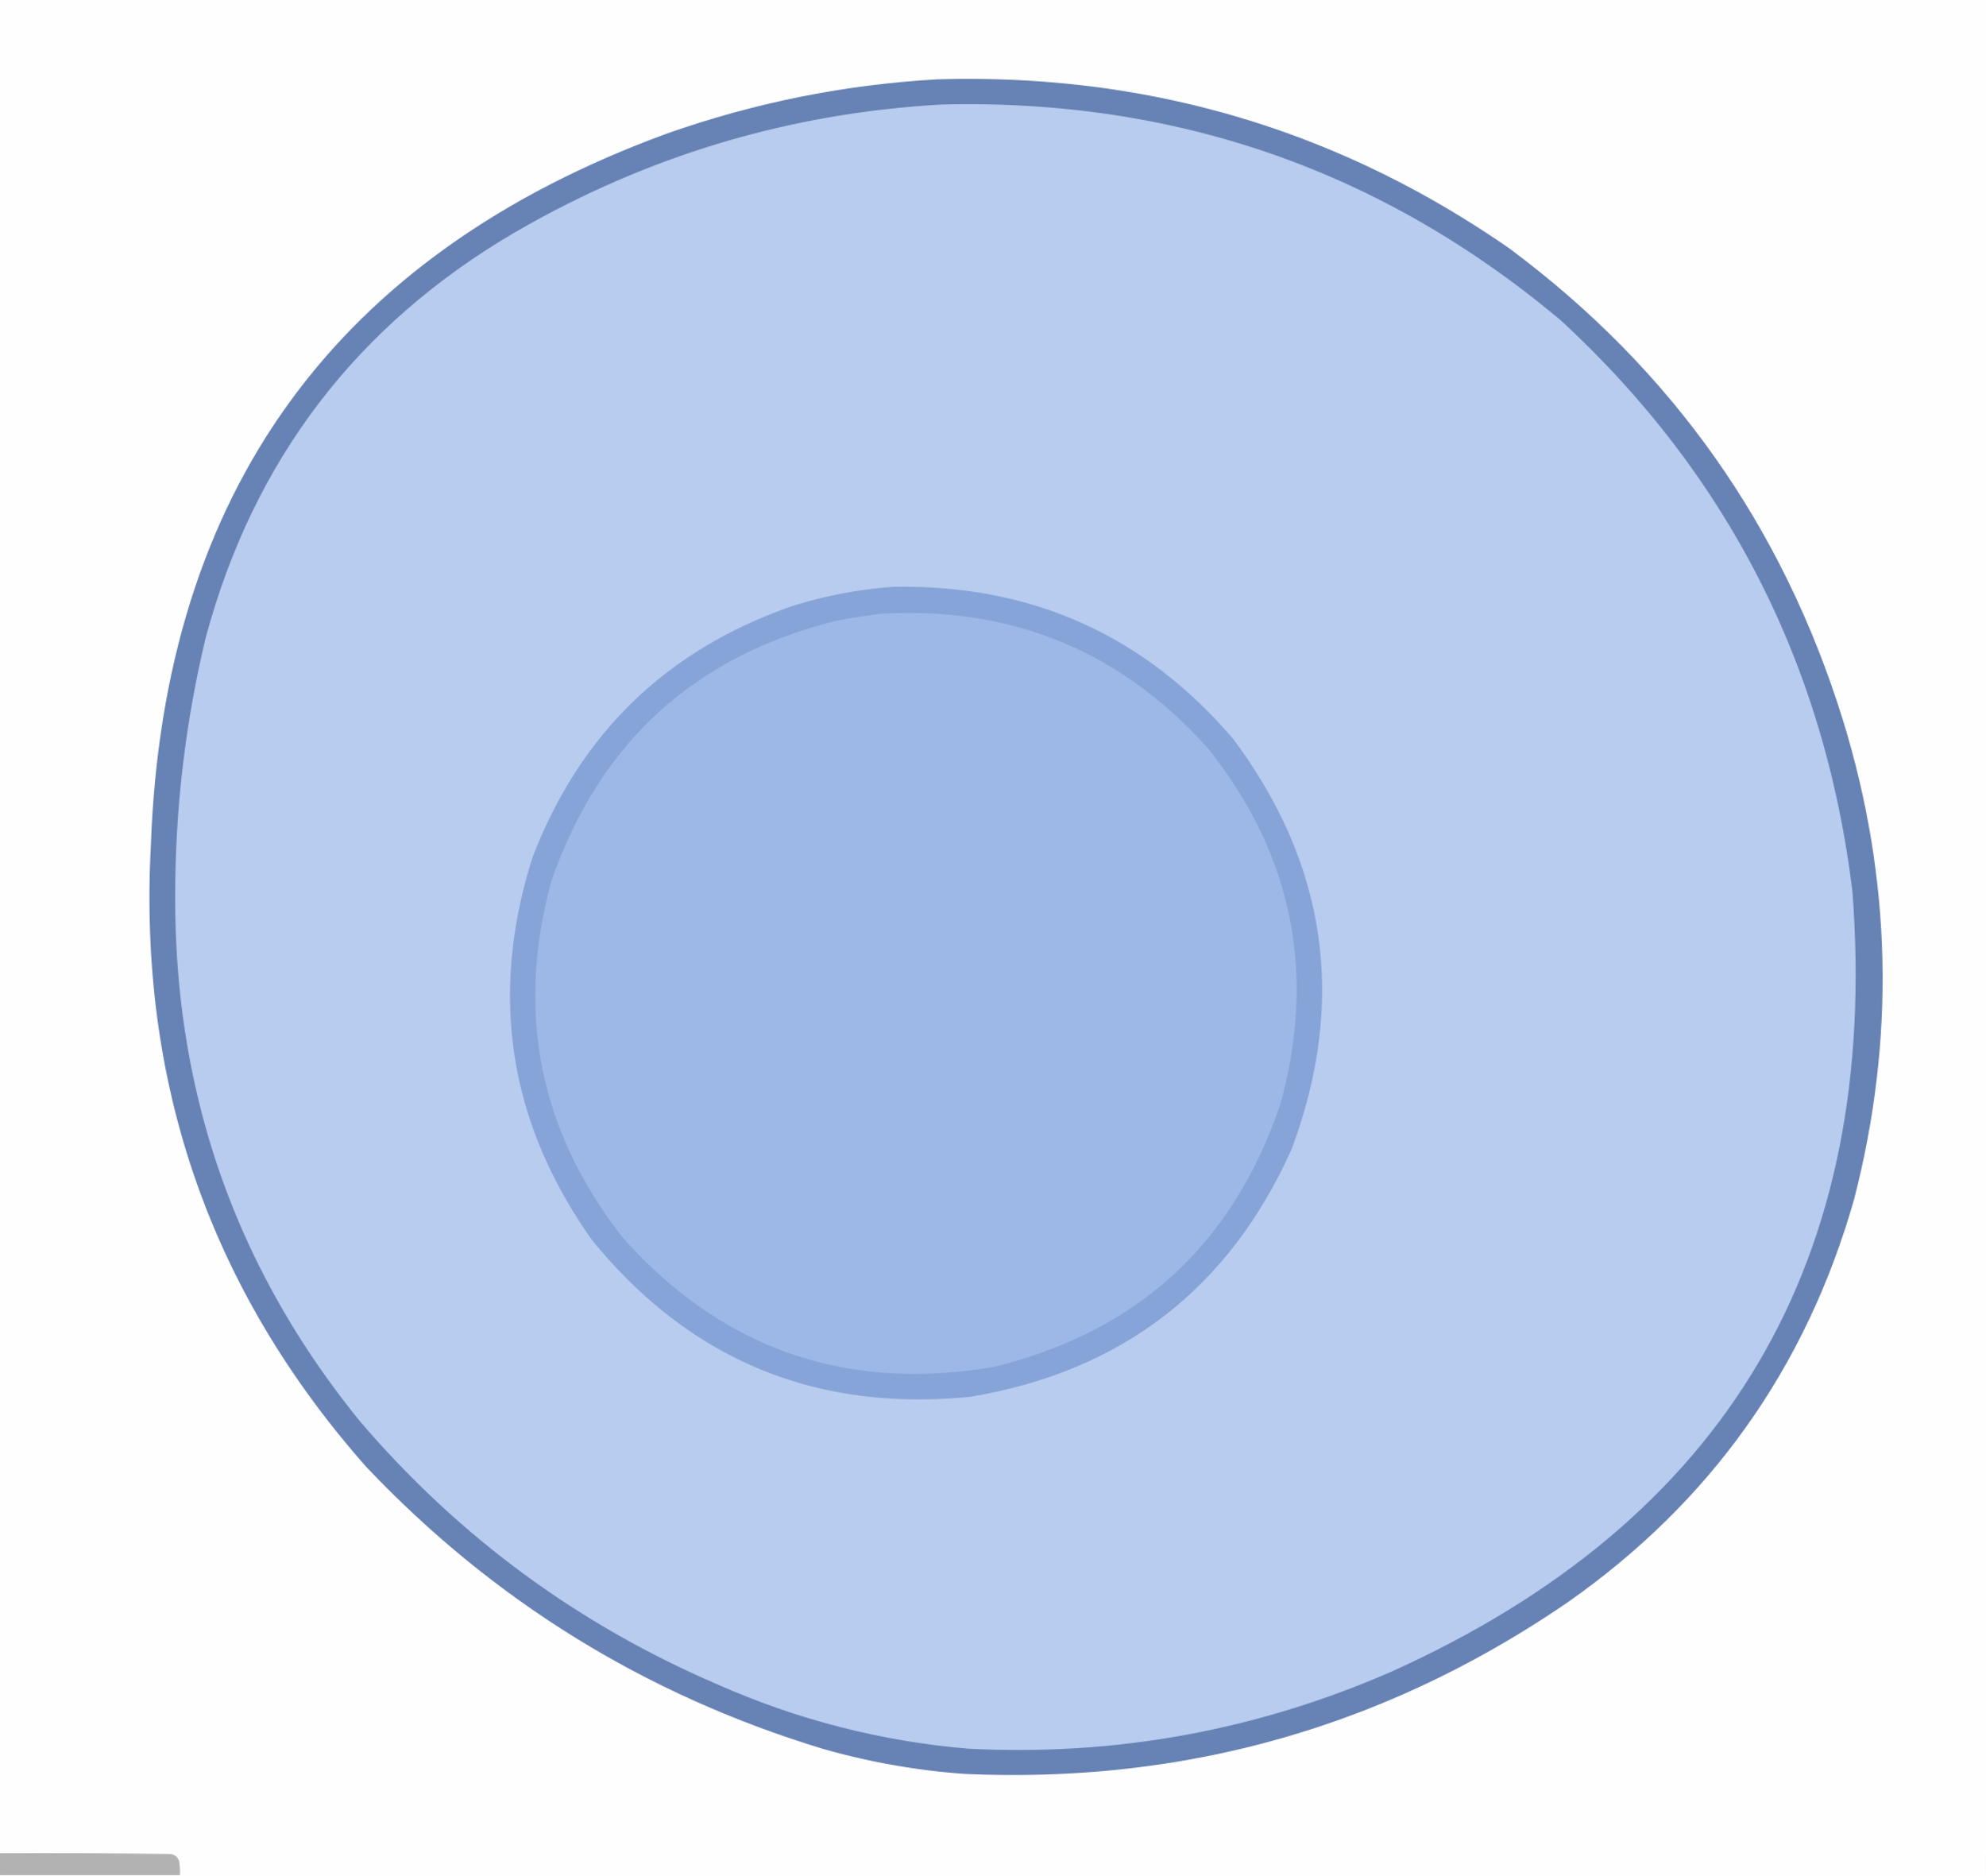

Searching for novel expression and epigenetic patterns captured by the model
Clustering genes based on their representations learned by the VAE (explore the latent space)
Dataset
Cluster n
Feature distributions
TSS plots
VAE
Encoder
GMM clustering
6D latent space
UMAP
2D projection
Gene expression pattern
80 clusters of genes
Term enrichment analysis
GE
Overlap with gene lists
CT max FPKMs
Active/Bivalent in ESC
100%
Notes:
To explore the latent space of the VAE and Searching for novel expression and epigenetic patterns captured by the model, we clustered genes based on their representations in the latent space.
Additionally, to visualize the overall distribution of genes in the latent space, we projected the six-dimensional latent space to two dimensions using UMAP. Here for example the scatterplot depicting the projection of the latent space is colored by clusters, but it can be colored by input features or external to see the overall gene distribution in dependence of specific features.
By selecting some clusters, we showed how VAE latent code successfully grouped together
genes based on common features dynamics

Slide 20
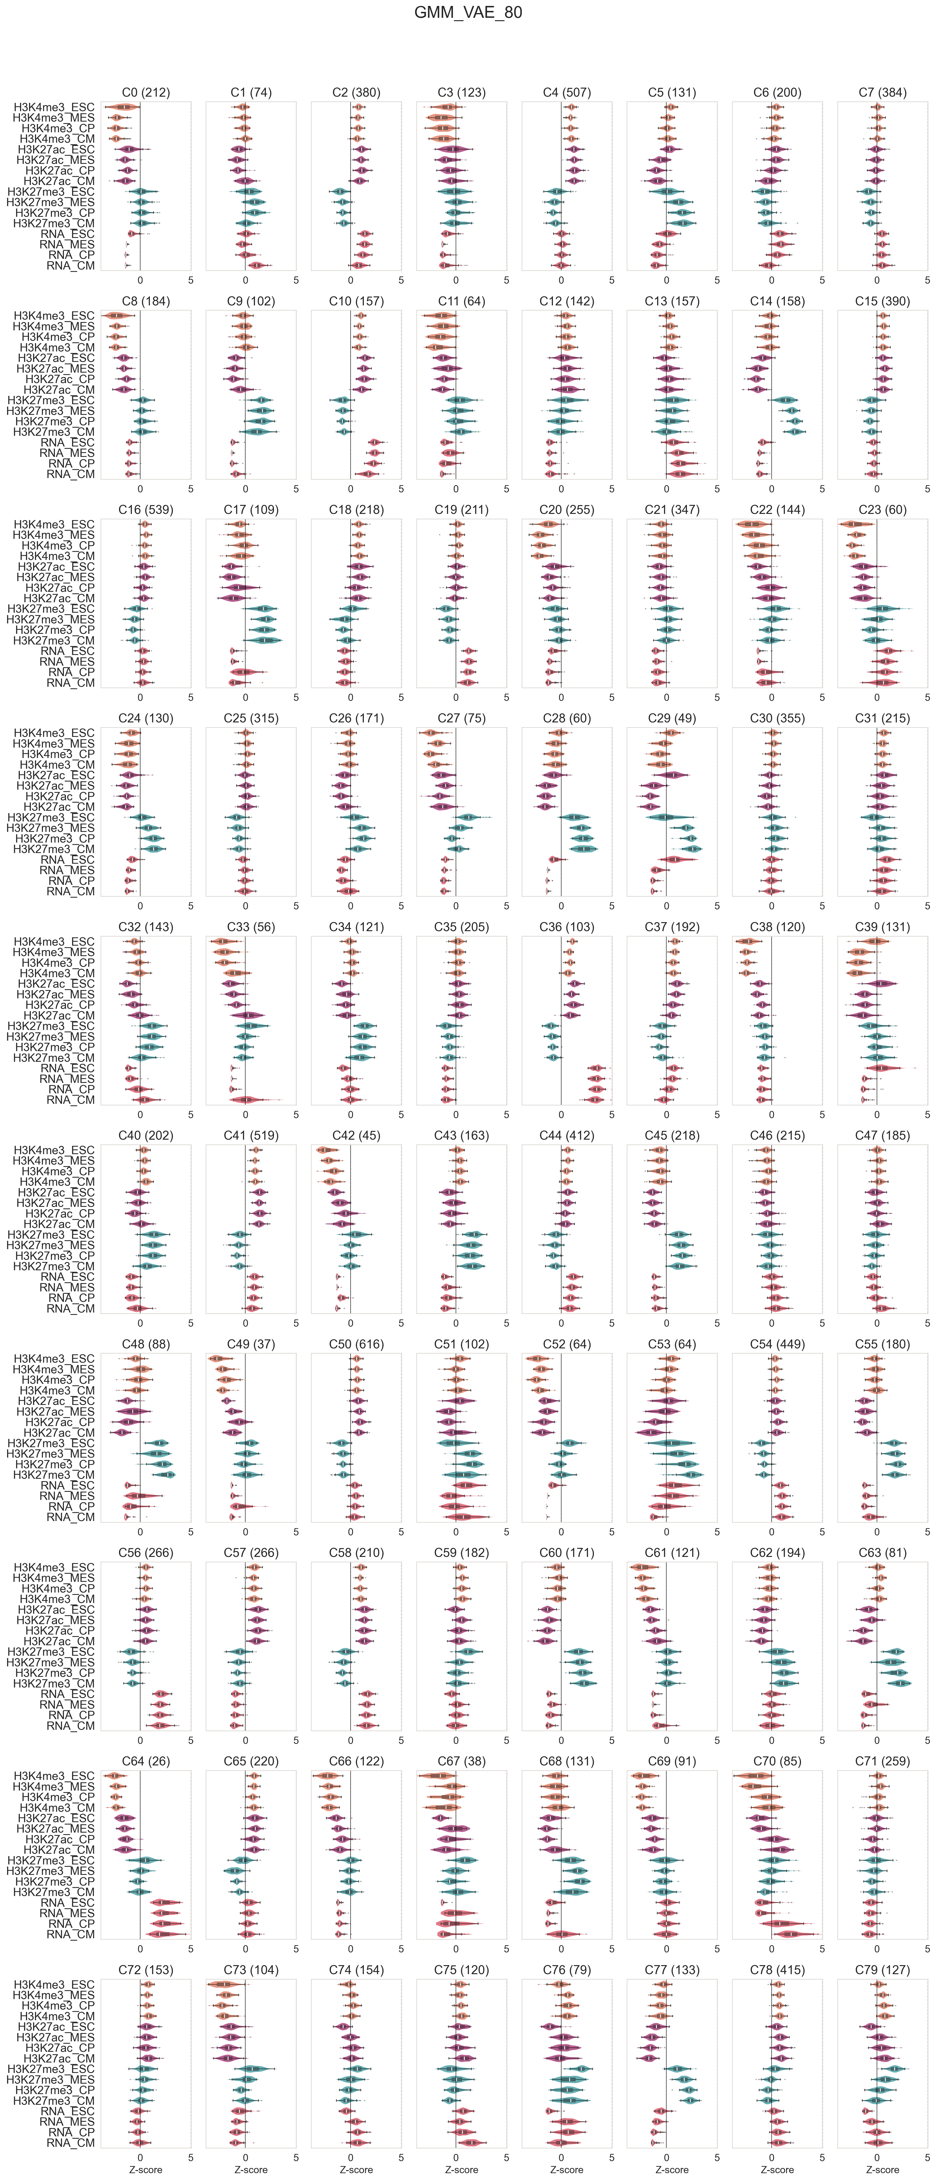
Cluster 32: Bivalent genes in ESC which are activated in CM
# of genes = 143
Transcription Starting Site MetaPlots (Avg ChIP signal)
Features distributions
RNA
ESC
MES
CP
CM
Active: H3K4me3(+) and H3K27me3(-)
Bivalent / poised: H3K4me3(+) and H3K27me3(+)
Z-score
Notes:
As an example, here I present cluster 32, which contains genes that we labeled as bivalent in ESC and activated in cardiomyocytes. On the left, the violin plot shows the feature distribution, color-coded by group and ordered top to bottom according to the differentiation trajectory. On the right, the epigenetic dynamics is illustrated by average ChIP signal profiles around promoters, calculated for each cell type and histone modification.
The key inisight regarding the expression dynamics is that these genes show low expression value in the first stages of differentiation and higher expression value in the latter .
By looking at the epigenetics dynamics wwe can infer that genes appear to be repressed in teìhe firststages of tdifferetnaiton in a socalled bivalent state, having both H3K4me3 and H3K27me3, this condition is known as bivalent and genes are transcription poised and ready to be activated or repressed. in this case they get activated in CM by losing the repression mark suggested genes are important so expressed and important in CM

Slide 21
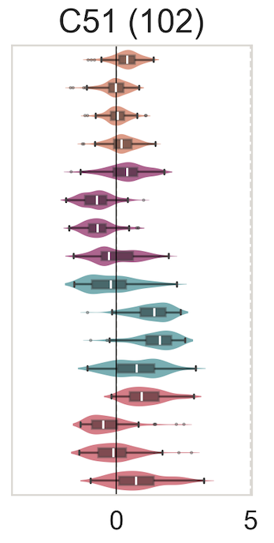
Cluster 51: Valley-like expression pattern, bivalent in mid-stages
# of genes = 102
Transcription Starting Site MetaPlots (Avg ChIP signal)
Features distributions
RNA
ESC
MES
CP
CM
Active: H3K4me3(+) and H3K27me3(-)
Bivalent / poised: H3K4me3(+) and H3K27me3(+)
Z-score

Slide 22
Cluster 51: Gene expression dynamics at gene resolution
16 randomly selected genes
Cell type
Notes:
To confirm the expression dynamic pattern at gene resolution here we randomly selected 16 genes and plot their expression along differentiation, and you can see how all of them show the valley like expression part with some differences.

Slide 23
Visualize clusters composition in term of chromatin state of the genes
Composition of clusters in terms of chromatin state annotation in ESC (Gonzalez et al., 2021)
0%
100%
Notes:
”Given the large number of clusters, we are still analyzing them, trying to extract insights and assign labels. Here, I present a method to visualize the composition of all clusters in terms of chromatin state. Specifically, for each cluster, we plot the percentage of genes annotated with different chromatine states in ESC in a previous study, providing a first hint and general idea that can help to select clusters.
The same type of visualization applied with anither annotation categories can provide a different perspective on clusters composition

Slide 24
Conclusion
This study presents a VAE-based clustering pipeline to capture gene expression and epigenetic dynamics patterns in cardiac differentiation, serving as a proof of concept for a flexible framework that could be generalized to other biological scenarios.
One cluster revealed a novel gene regulation pattern during cardiac differentiation, including chromatin states transitions from active to bivalent states and reactivation in cardiomyocytes

Slide 25
Limitations and possible improvements
Systematically optimize the num. of dimensions of the latent space
Jointly training the VAE and clustering models (end-to-end clustering)
Account for ChIP-levels in enhancers
Apply it in more complex biological contexts, such as:
  Multiple conditions: Healthy vs. Cancerous tissue, Wild-type vs. Knockout models
  Add other experiment types: Chromatin accessibility, DNA methylation

Slide 26
Thank you for your attention!
Thanks to the members of Di Croce Lab (CRG, Barcelona) for their support, with special gratitude to Enrique and Luciano for their help and contributions

Slide 27
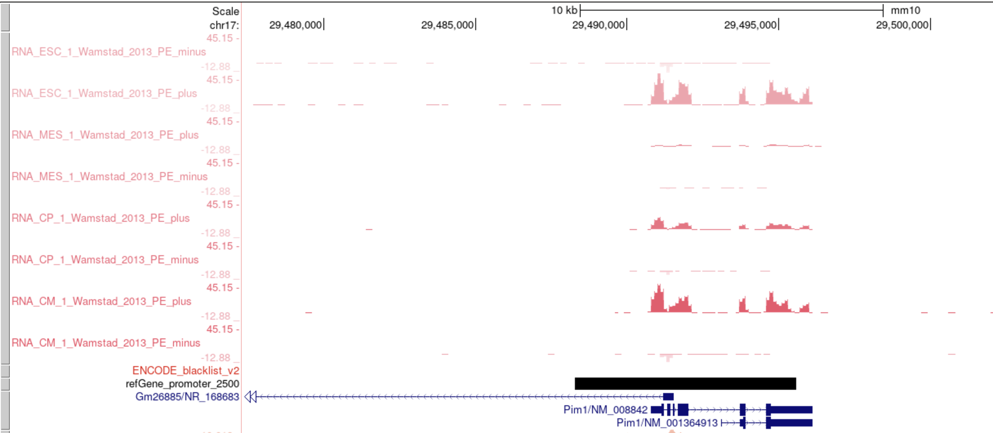
C51: Valley-like expression pattern, bivalent in mid-stages
Pim1

Slide 28
Methods workflow
Dataset split
QC
AE and VAE hyperparameters optimization
Reconstruction performances comparison
with AE, PCA, UMAP
ChIP-seq
samples
Preprocessing
normalization
VAE Encoder
GMM clustering
Clusters of genes
sharing expression and epigenetic dynamics
Concatenate
Dataset
6D latent space/
embedding
RNA-seq
samples
Preprocessing
normalization
UMAP visualization in 2D
QC

Slide 29
VAE architecture with best hyperparameters
Reconstructed
Output
Input
PReLU
BN
μ
ChIP-levels
z
σ
RNA FPKMs
RNA logFCs
38
38
38
38
38
38
38
38
PReLU: Parametric Rectified Linear Unit (Activation function)
BN: Batch normalization

Slide 30
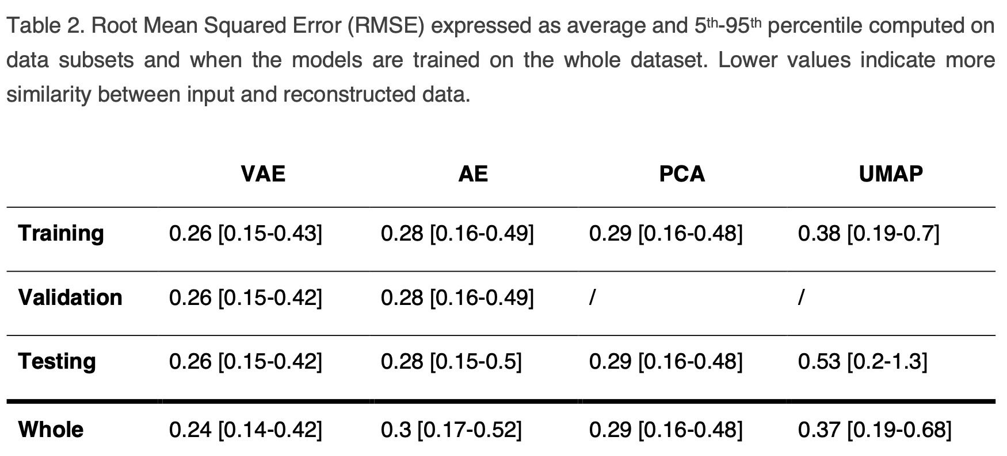
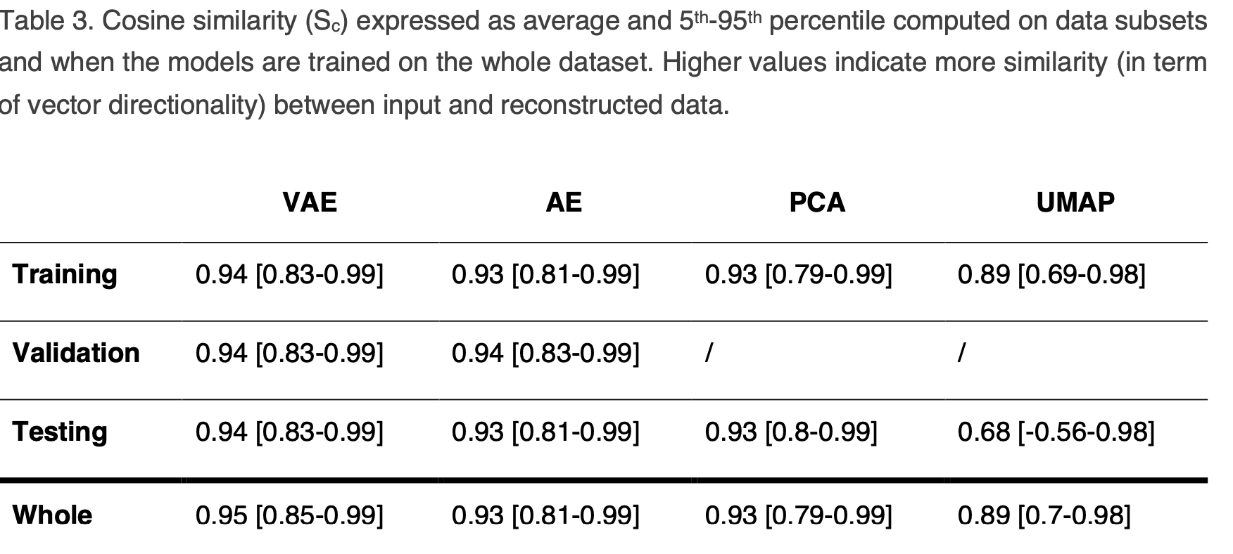
RMSE
Lower is better
Cosine Similarity
Higher is better

Slide 31
Addition of expression LogFCs as features improve reconstruction
 | RMSE | Cosine Similarity
ChIP-levels + FPKMs | 0.28 [0.16-0.48] | 0.93 [0.79-0.99]
ChIP-levels + FPKMs + LogFCs | 0.24 [0.14-0.4] | 0.95 [0.85-0.99]
6 LogFCs
(All cell type combinations w/o repetition)
logFC(MES / ESC)
logFC(CP / ESC)
logFC(CP / MES)
logFC(CM / ESC)
logFC(CM / MES)
logFC(CM / CP)
The metrics were computed only on ChIP-levels + FPKMs, with VAE trained on whole data

Slide 32
Cluster 32: Bivalent genes in ESC which are activated in CM

Slide 33
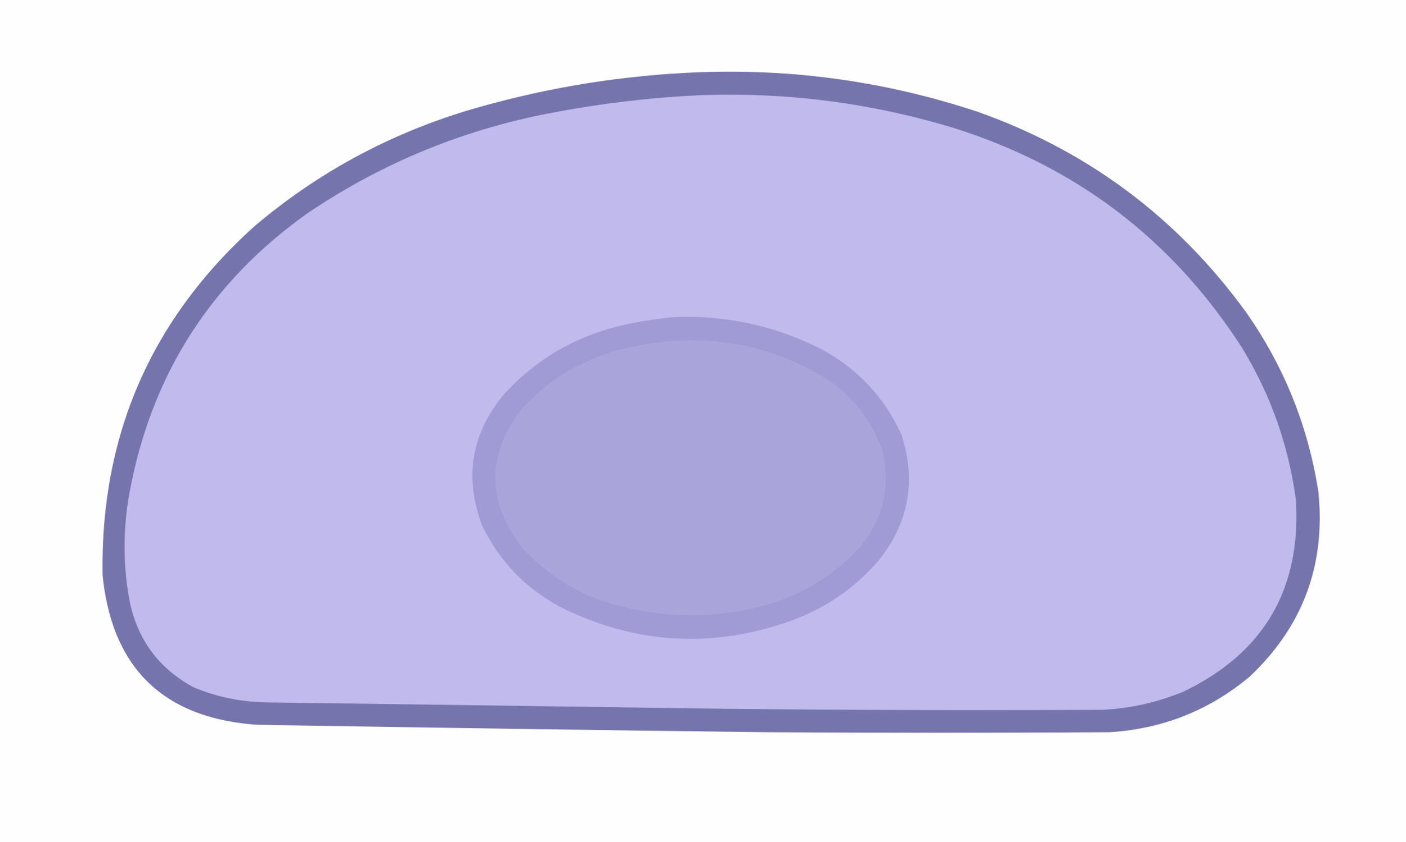
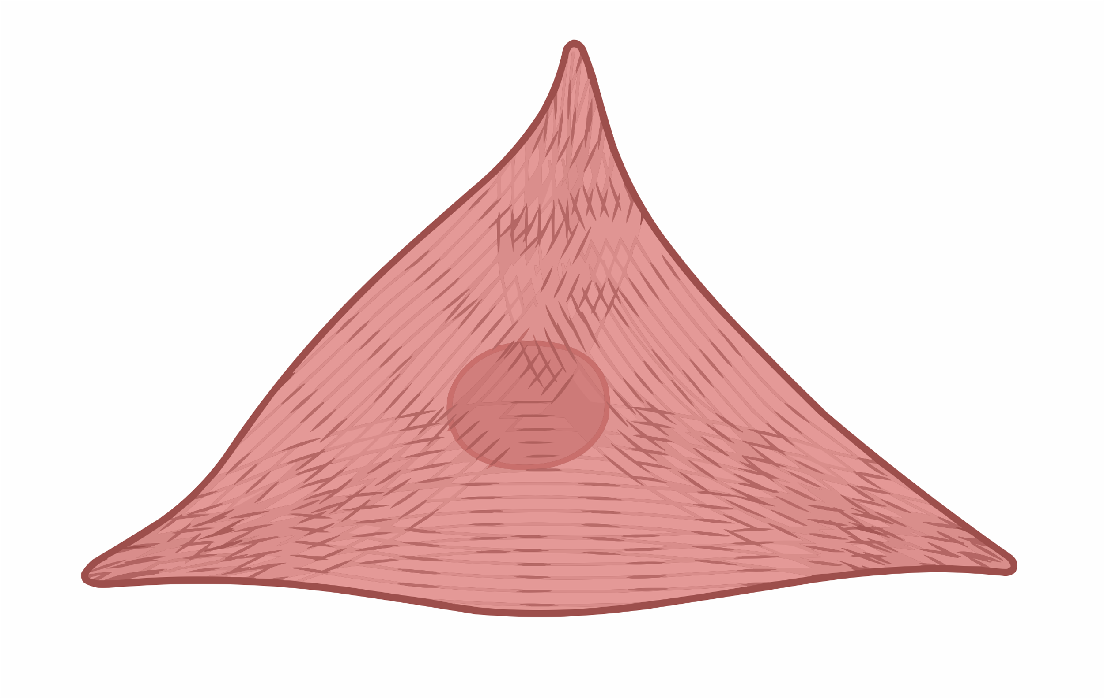
Four expression marker genes per cell type (differentiation stage)
ESC
MES
CP
CM

Slide 34
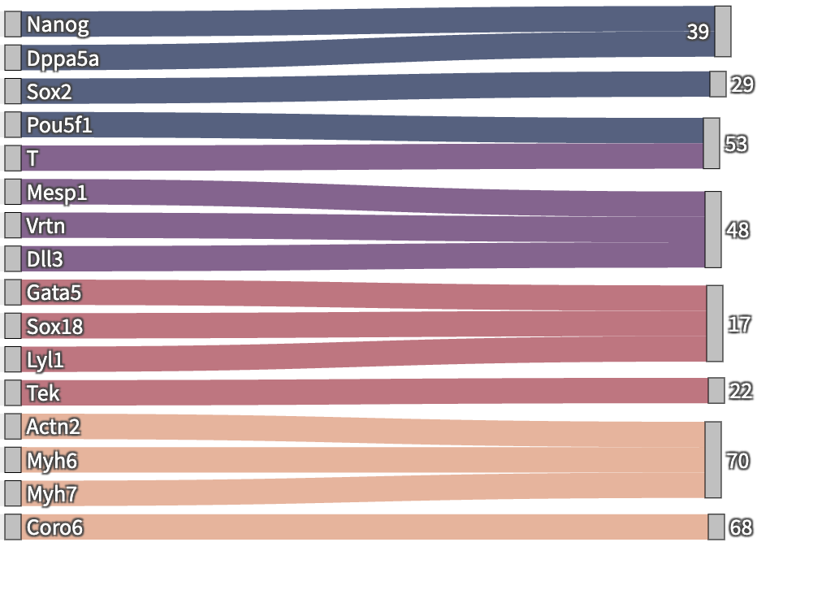
Distribution of marker genes among clusters
Marker genes
Clusters
ESC
MES
CP
CM

Slide 35
Cell type
a. C76
b. C70
c. C48
d. C51

Slide 37
Cell type marker genes reconstruction metrics compared to rest

Slide 38
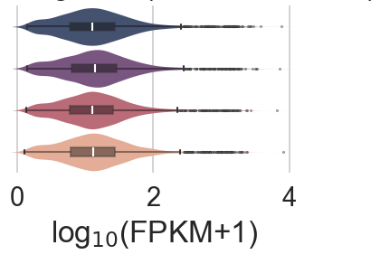
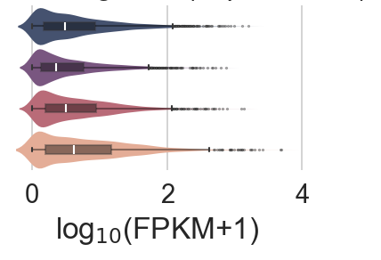
Coefficient of variation in expression to identify the most variable and stable genes
Cell type
a.
Bottom 4000
Top 4000
b.
Most STABLE genes
c.
Most VARIABLE genes

Slide 40
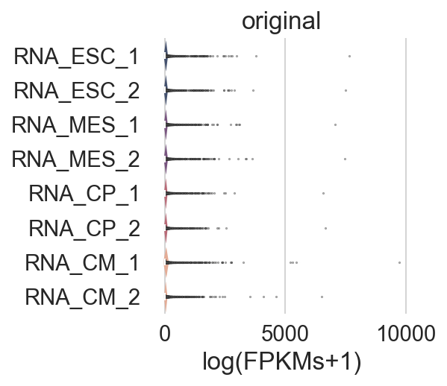
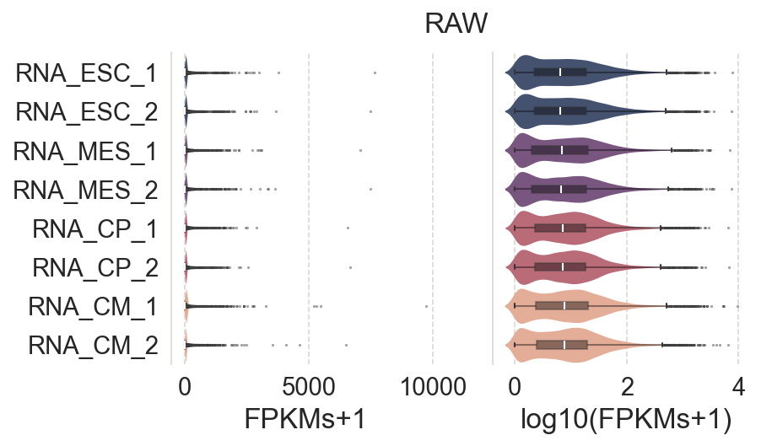
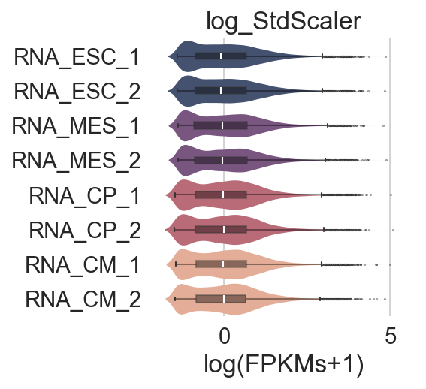
a.
b.
c.
Cell type
FPKM
log₁₀(FPKM+1)
Z-score
d.
e.
f.
PC2(14%)
PC2(26%)
PC2(26%)
PC1(76%)
PC1(60%)
PC1(60%)

Slide 41
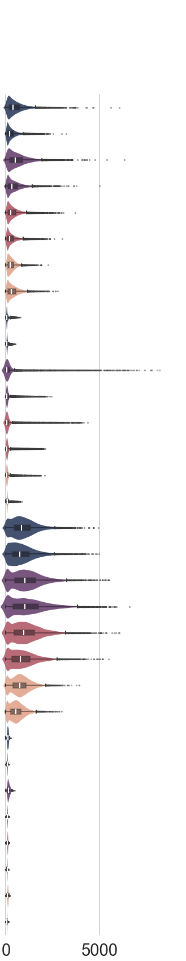
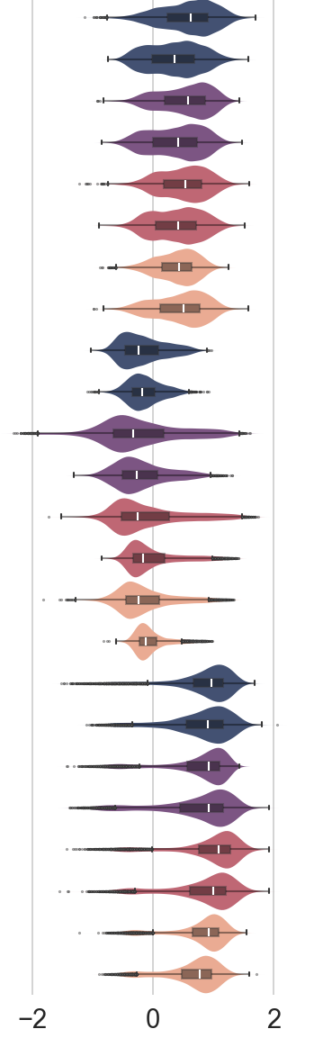
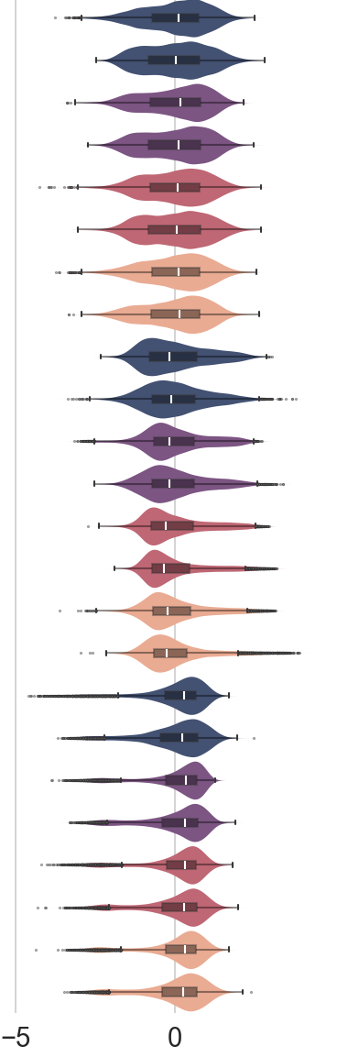
a.
b.
c.
ChIP target
Cell type
log₁₀(ratio)
Z-score
# of reads

Slide 42
a.
b.
3
c.

Slide 43
a.
Prior to background normalization (WCE)
ChIP target
Cell type
b.
After background normalization (WCE)

Slide 44
VAE
AE

Slide 45
a.
AE
b.
VAE

Slide 46
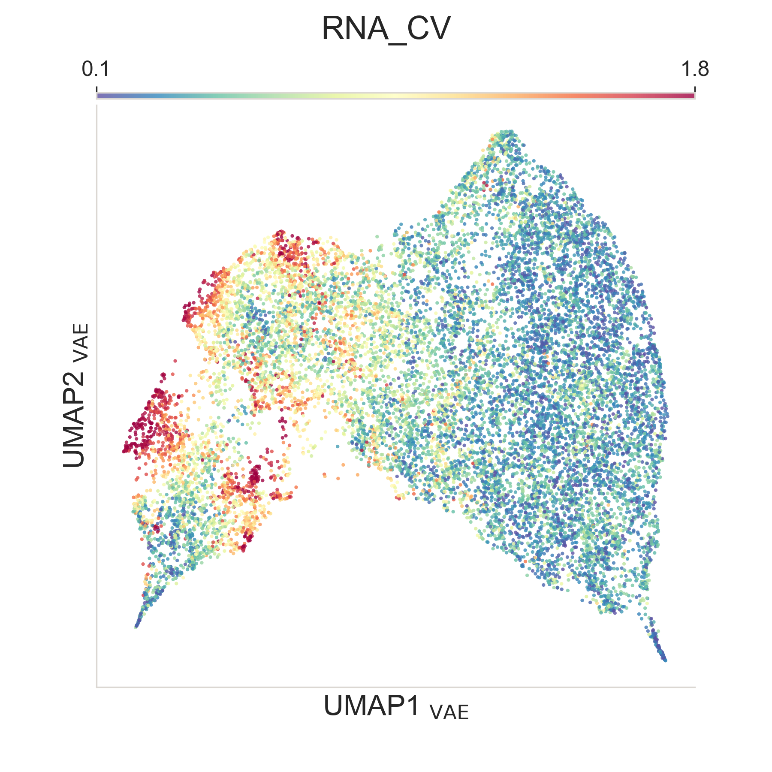
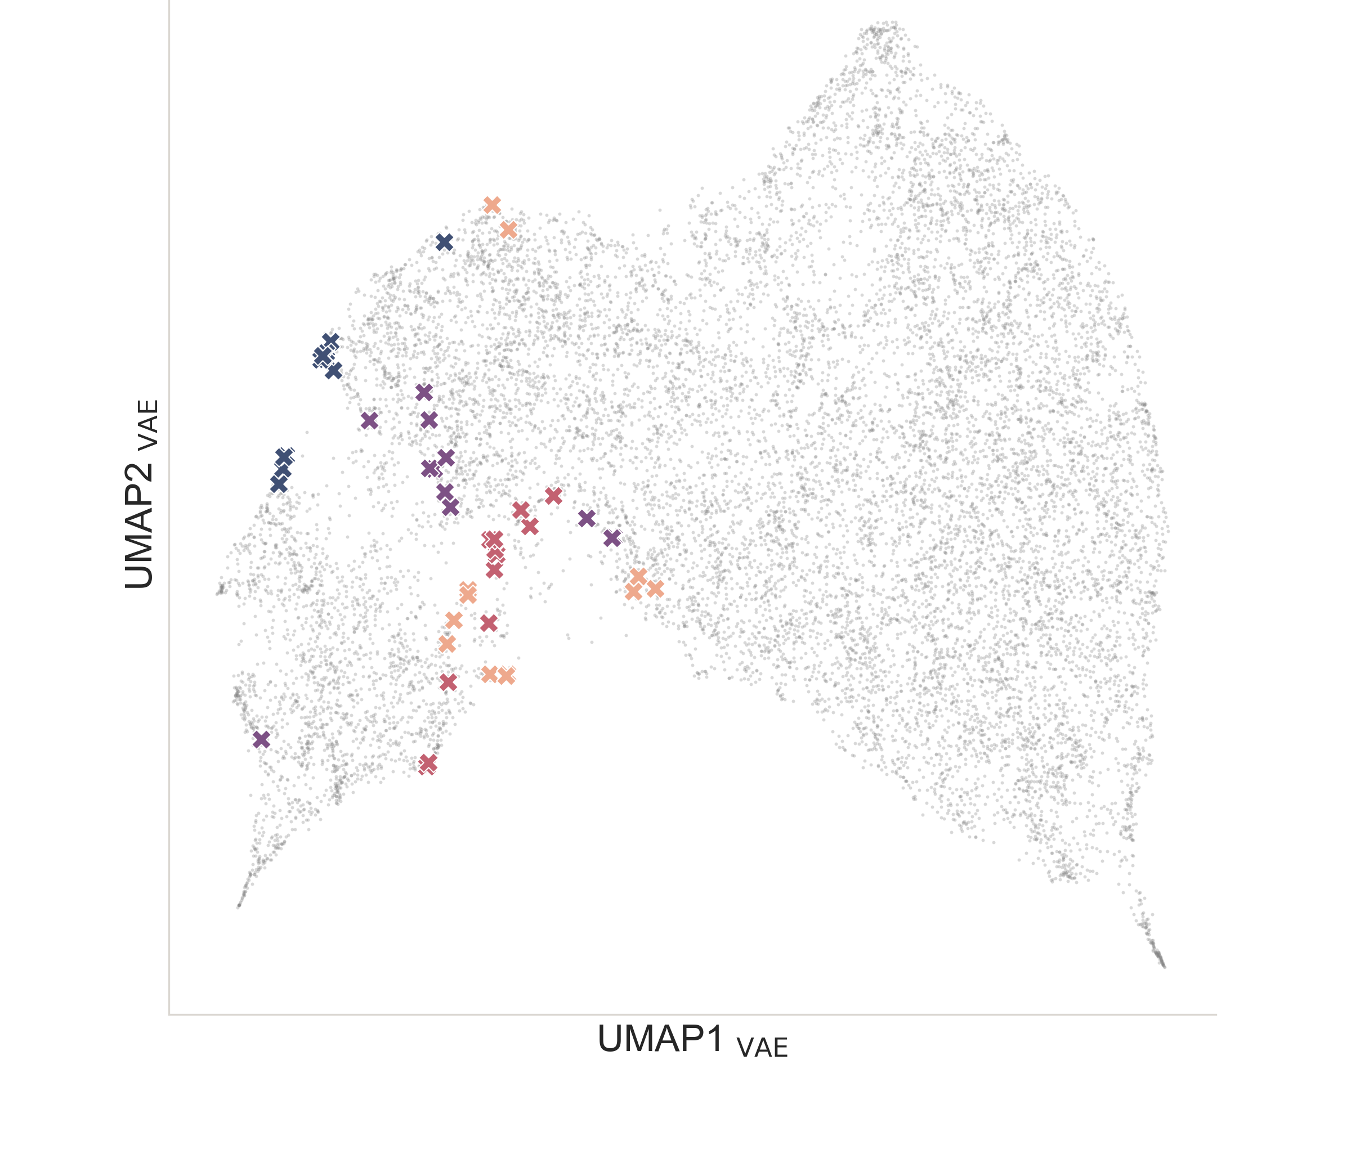
Cell type markers
CV_{FPKM}
a.
b.

Slide 47
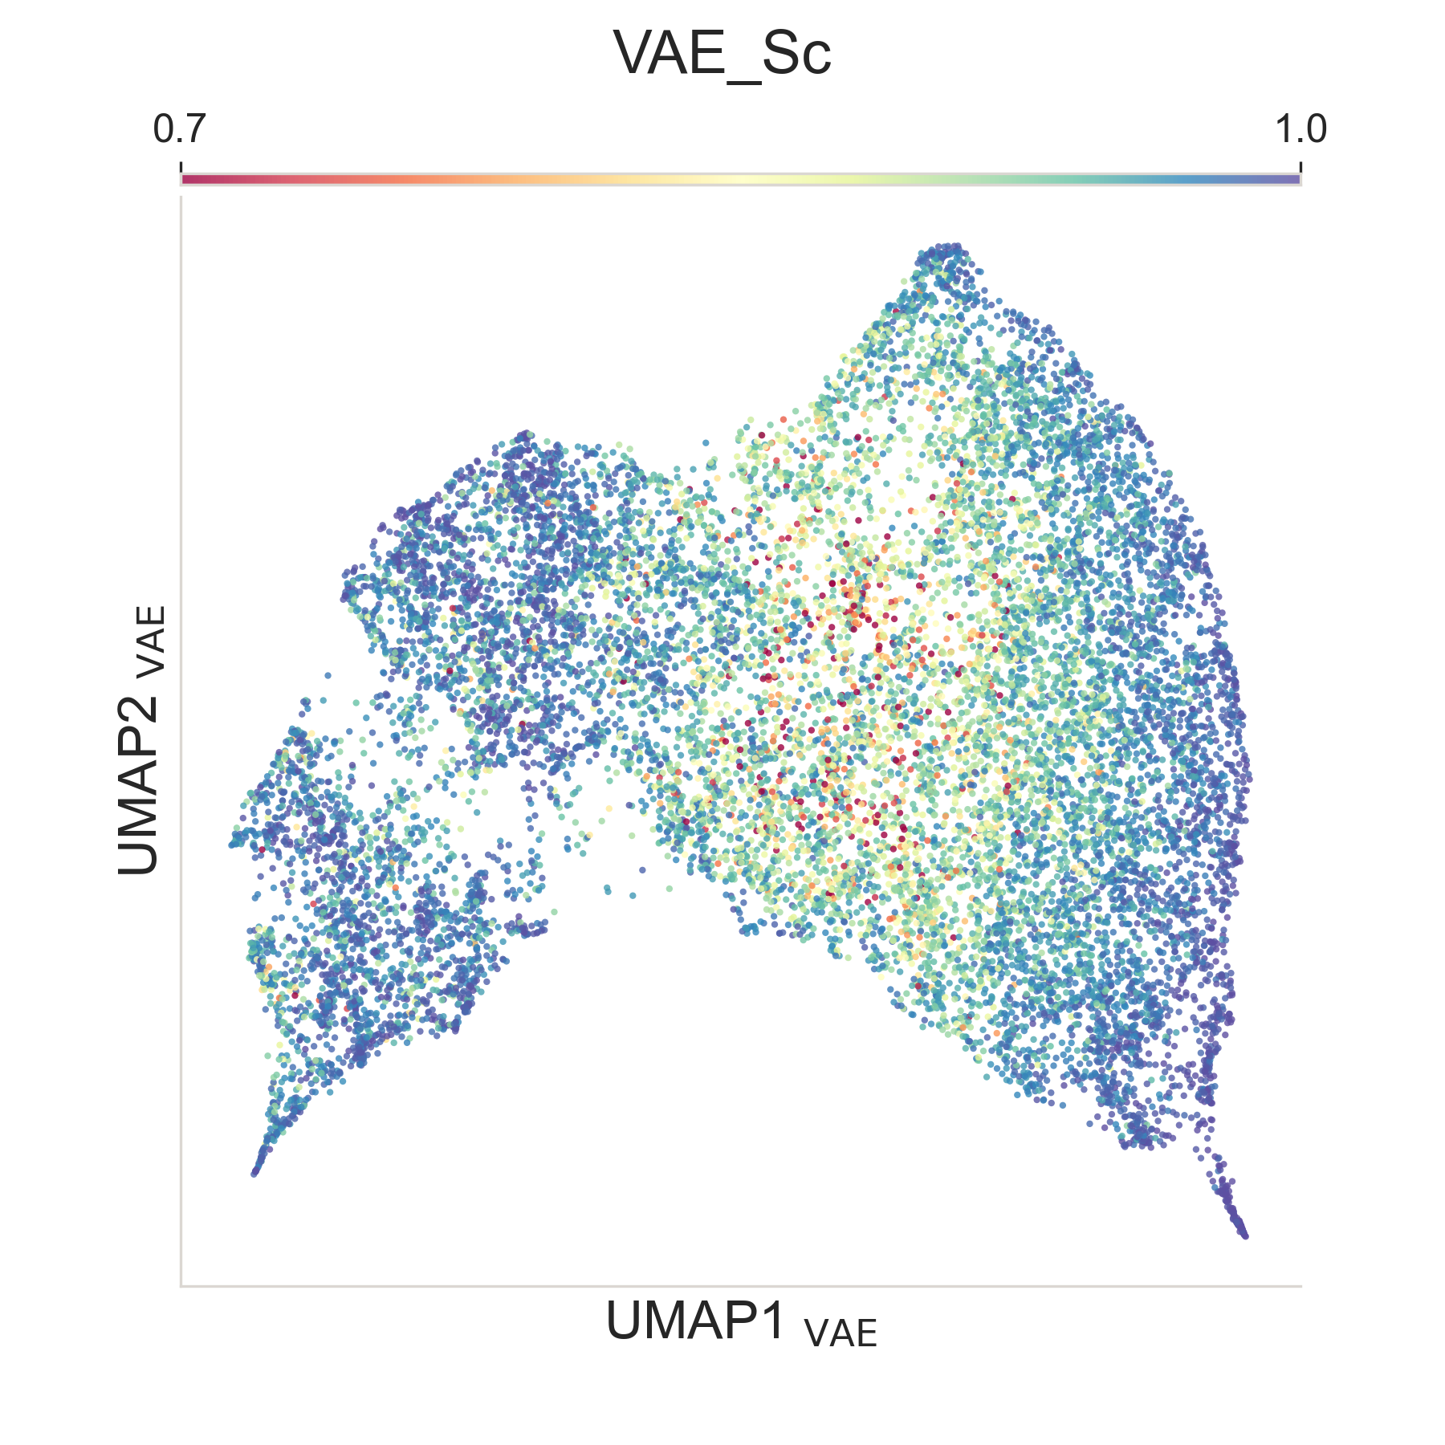
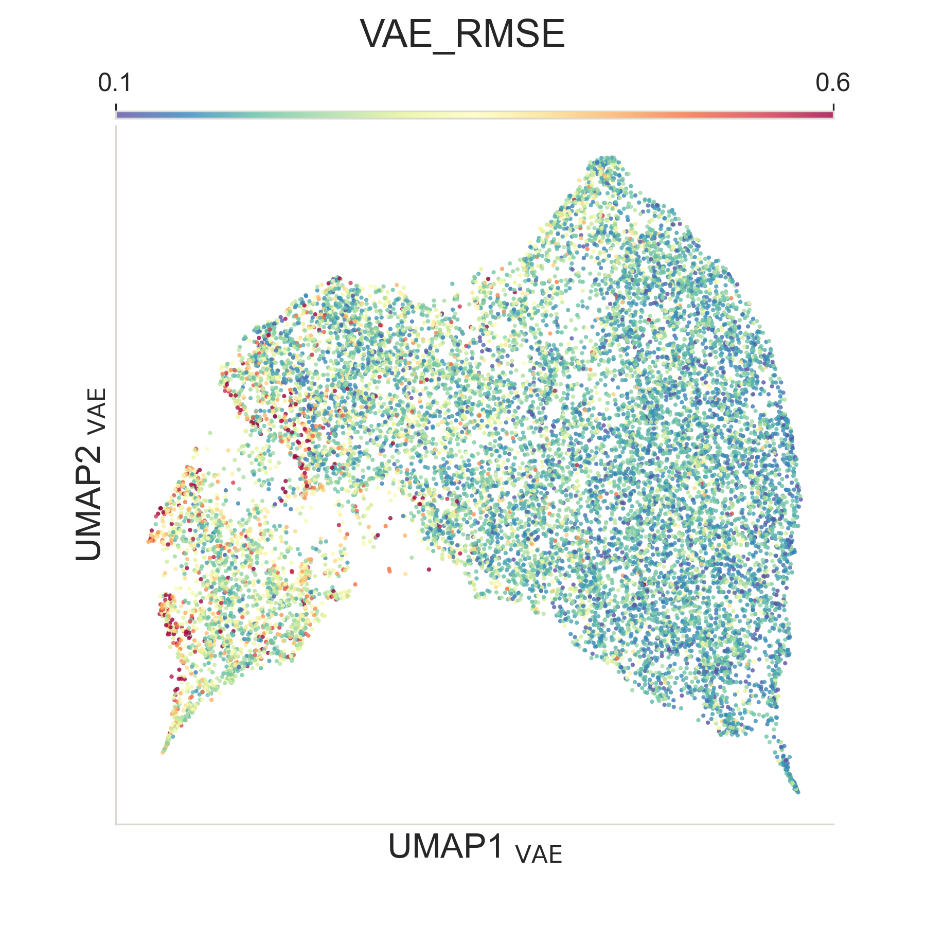
S_{c}
RMSE
a
b

Slide 48
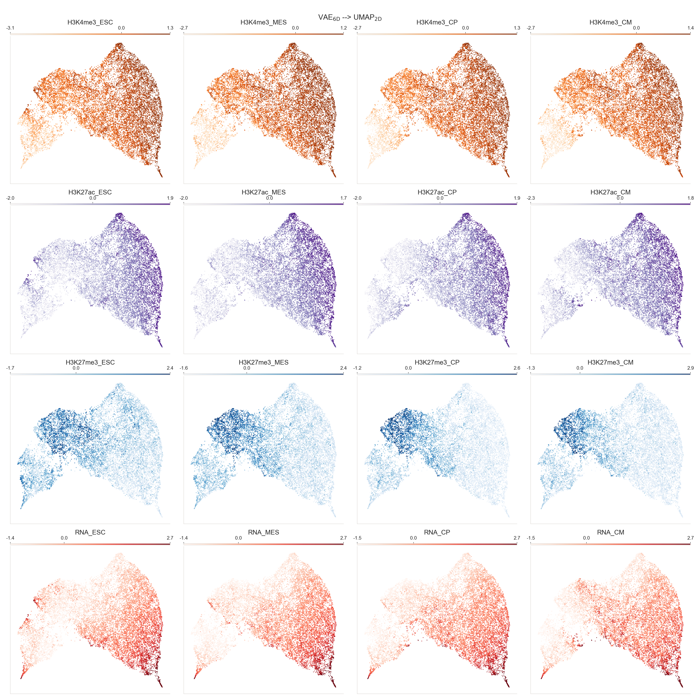

Slide 49
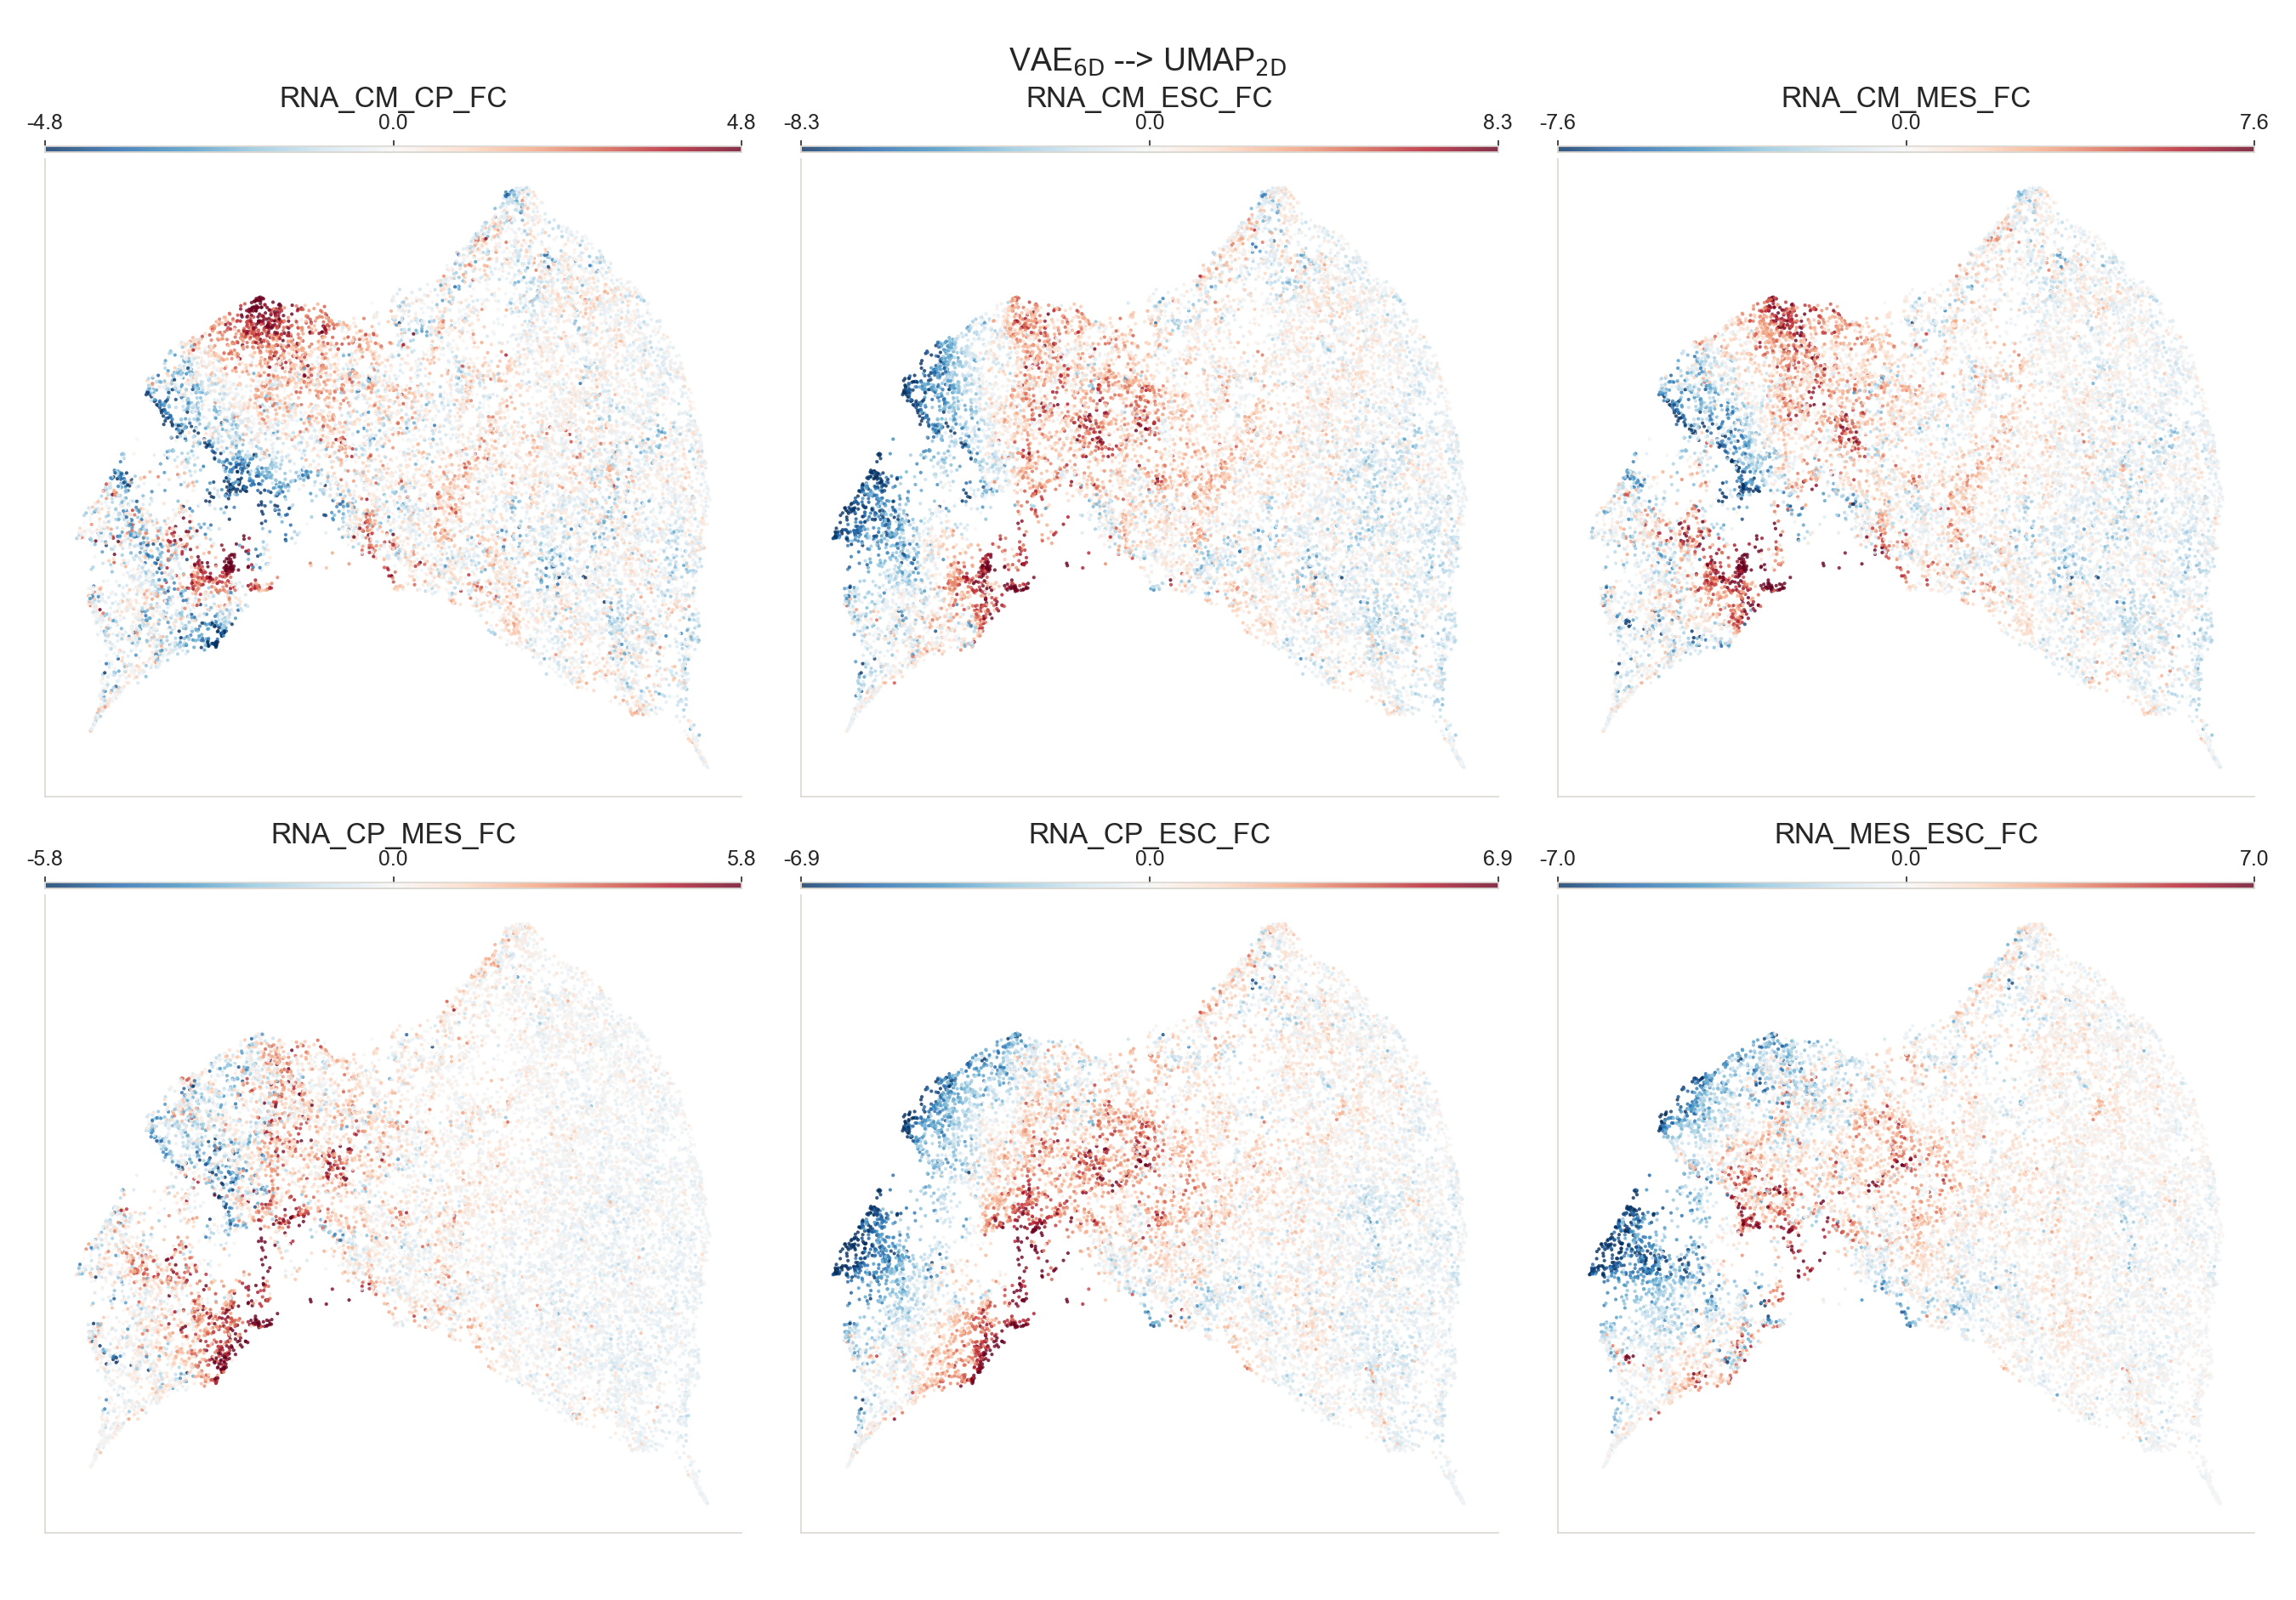

Slide 51
Composition of clusters in terms of variable genes (stratified by CT_{max}) and stable genes
Stable

Slide 52
Cluster 76: Developmental genes bivalent in ESC
b.
C76 (n=79)
Developmental genes bivalent in ESC
GE
a.
Feature group

Slide 53
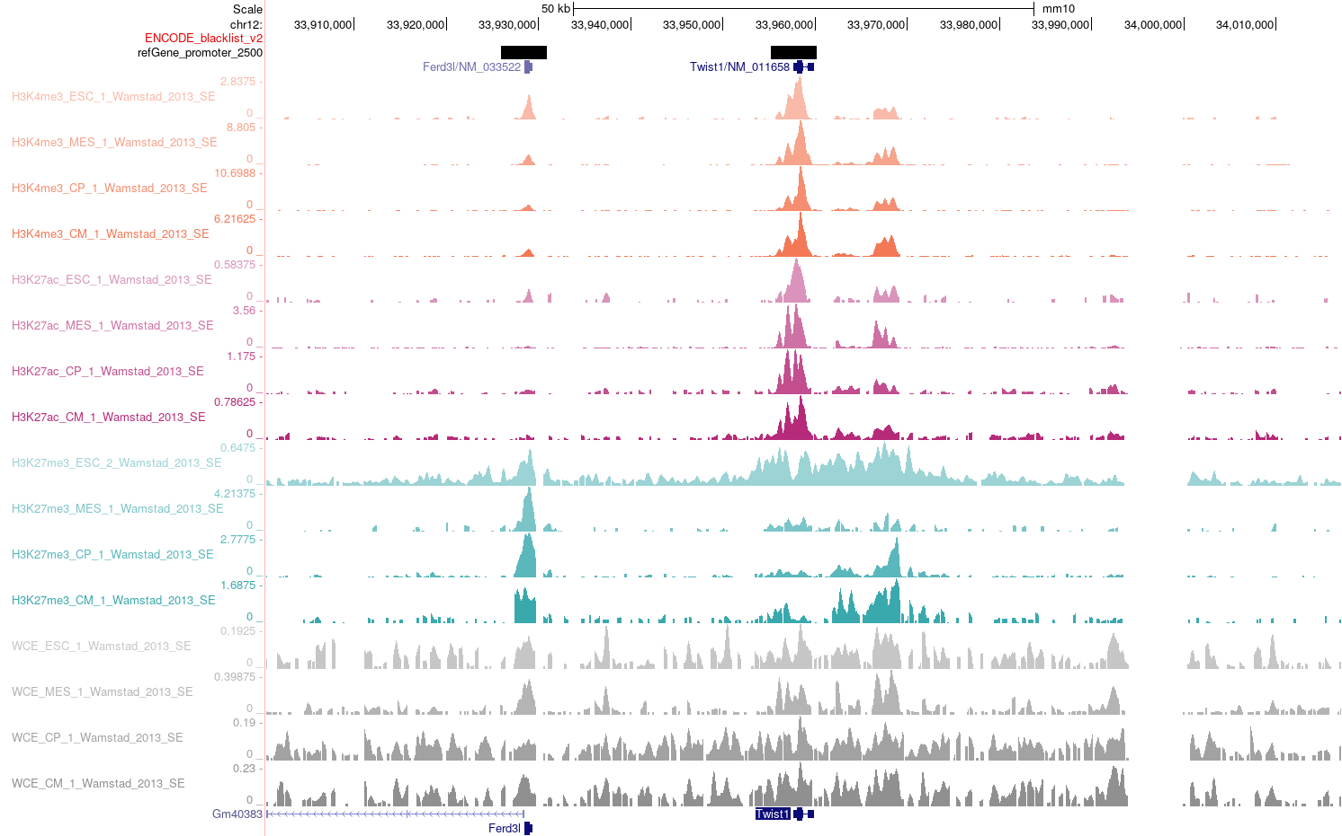
Cluster 76: Developmental genes bivalent in ESC
Twist1

Slide 54
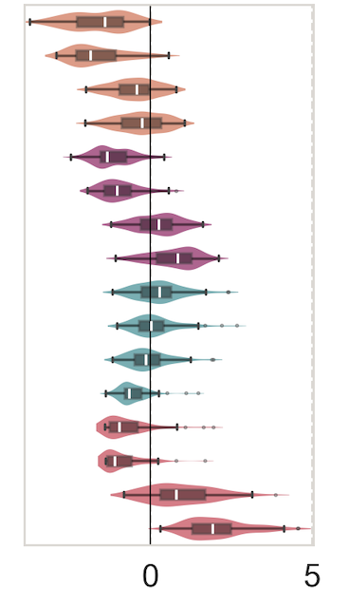
C70: Silenced genes activated in CM that are non-targets of Polycomb
b.
C70 (n=85)
Silenced genes activated in CM that are non-targets of Polycomb
GE
a.
Feature group

Slide 55
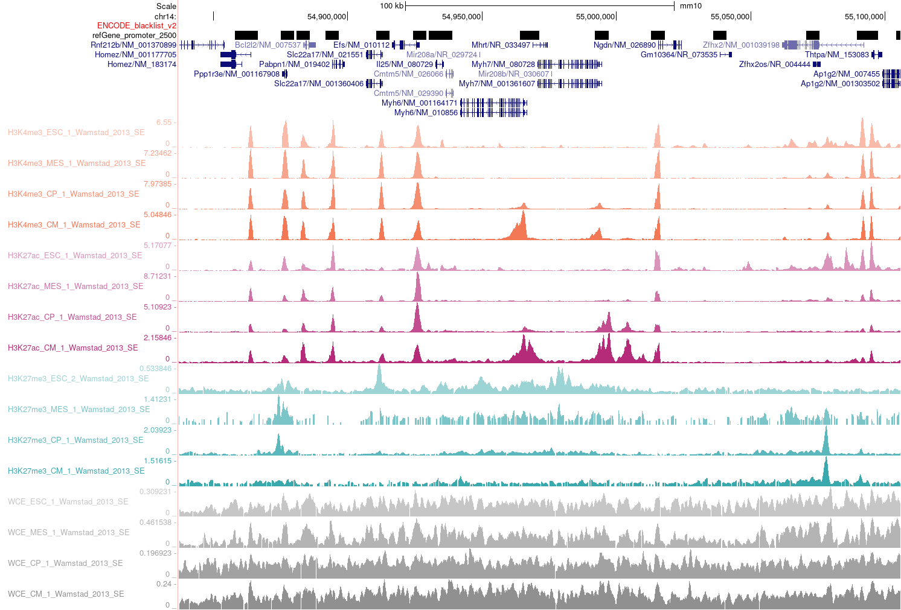
C70: Silenced genes activated in CM that are non-targets of Polycomb
Myh6-7

Slide 56
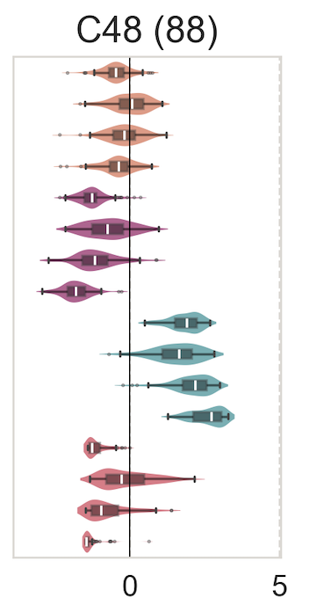
C48:Bivalent throughout the differentiation and expressed in mid-stages
b.
C48 (n=88)
Bivalent throughout the differentiation and expressed in mid-stages
GE
a.
Feature group

Slide 57
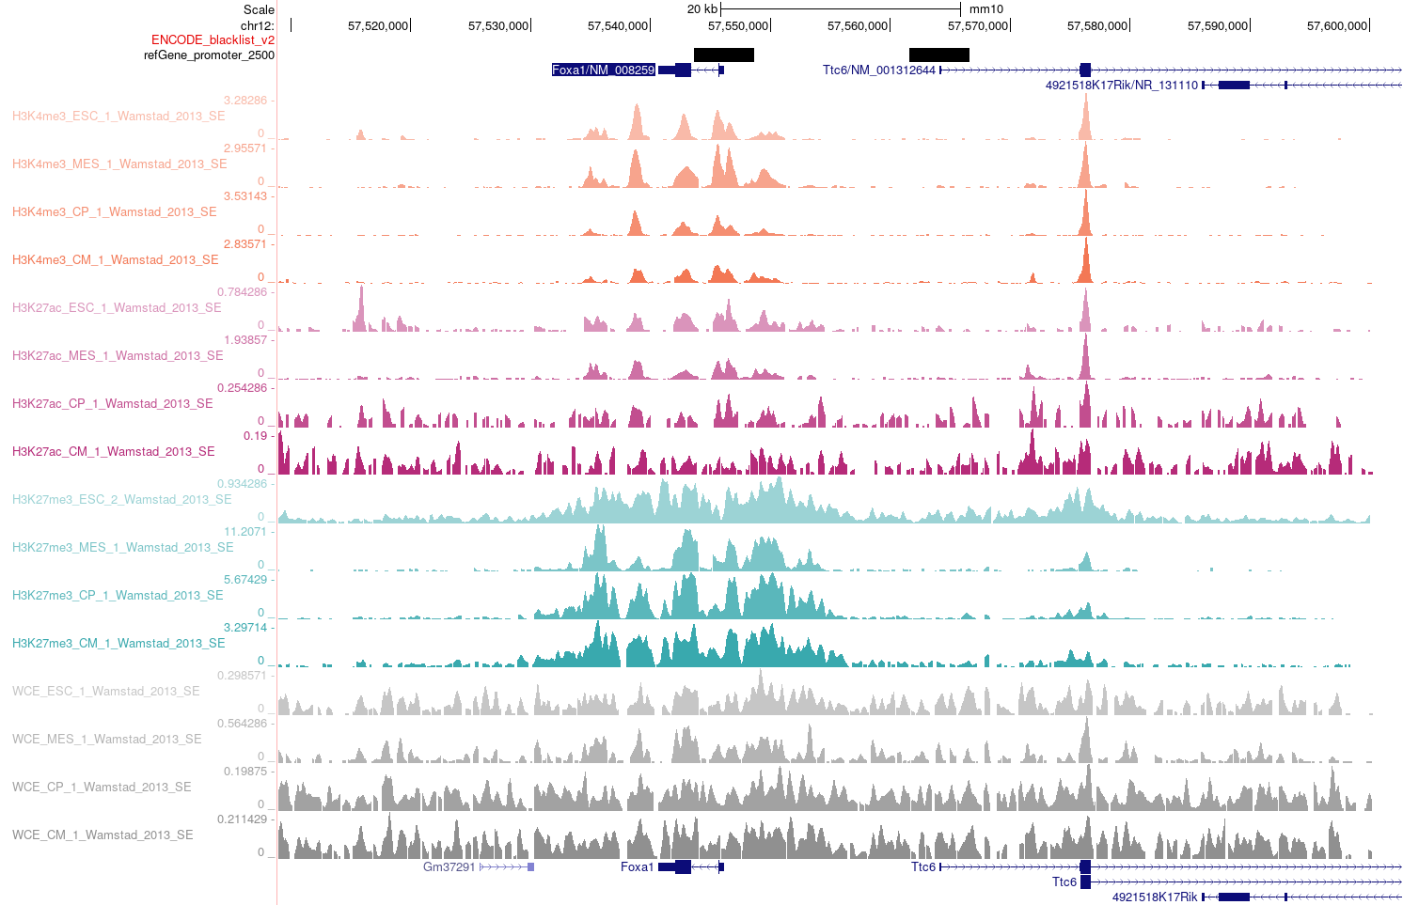
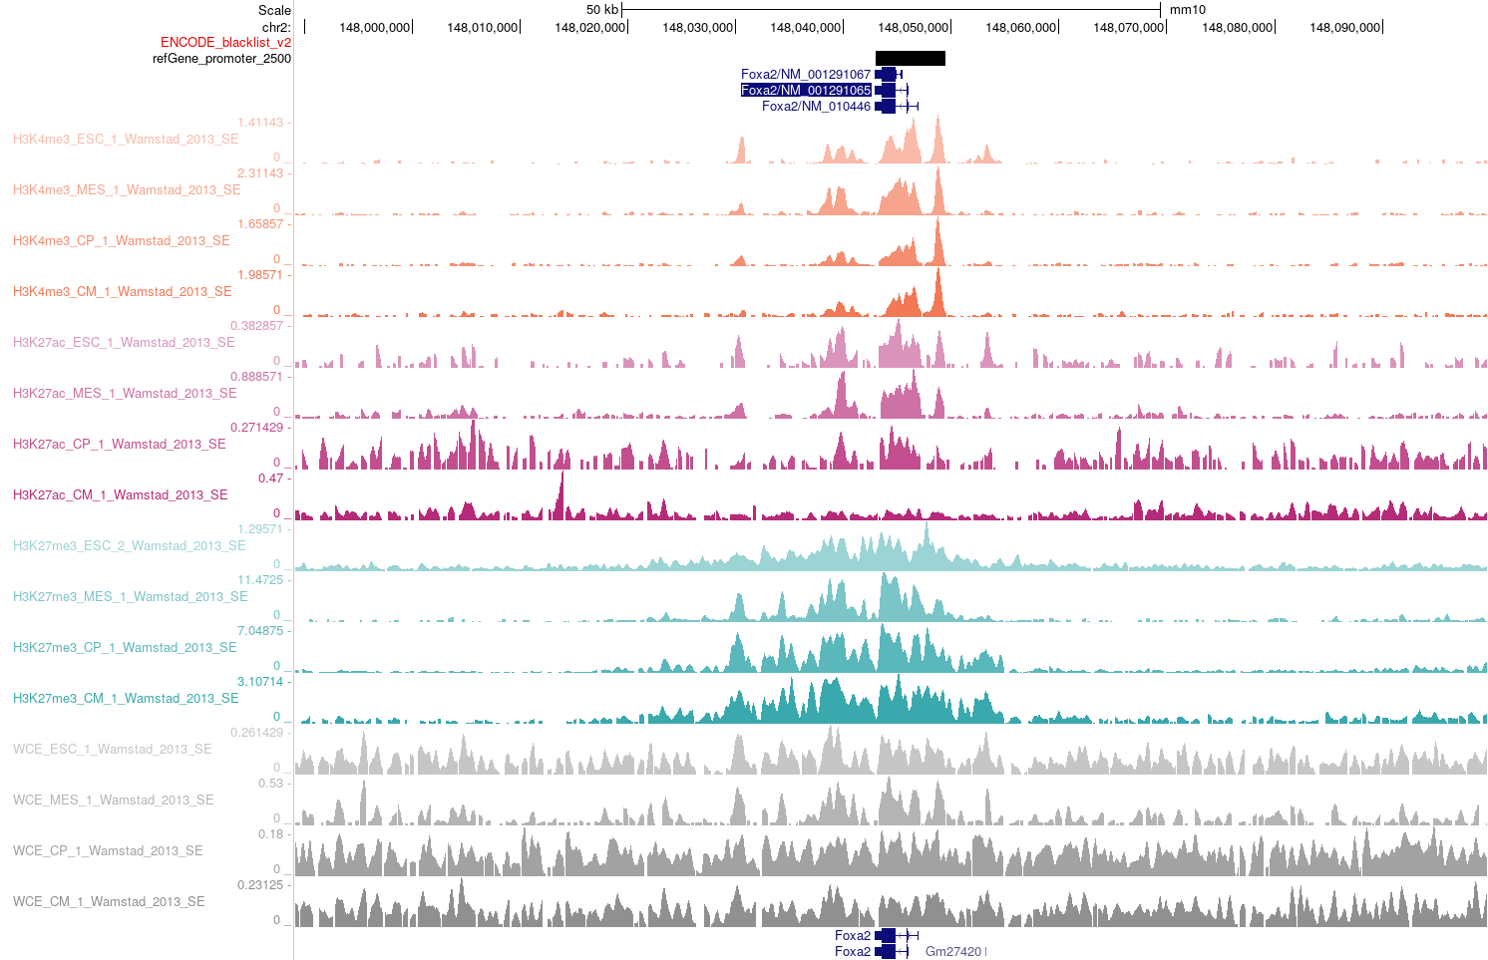
C48:Bivalent throughout the differentiation and expressed in mid-stages
Foxa1
Foxa2

Slide 58
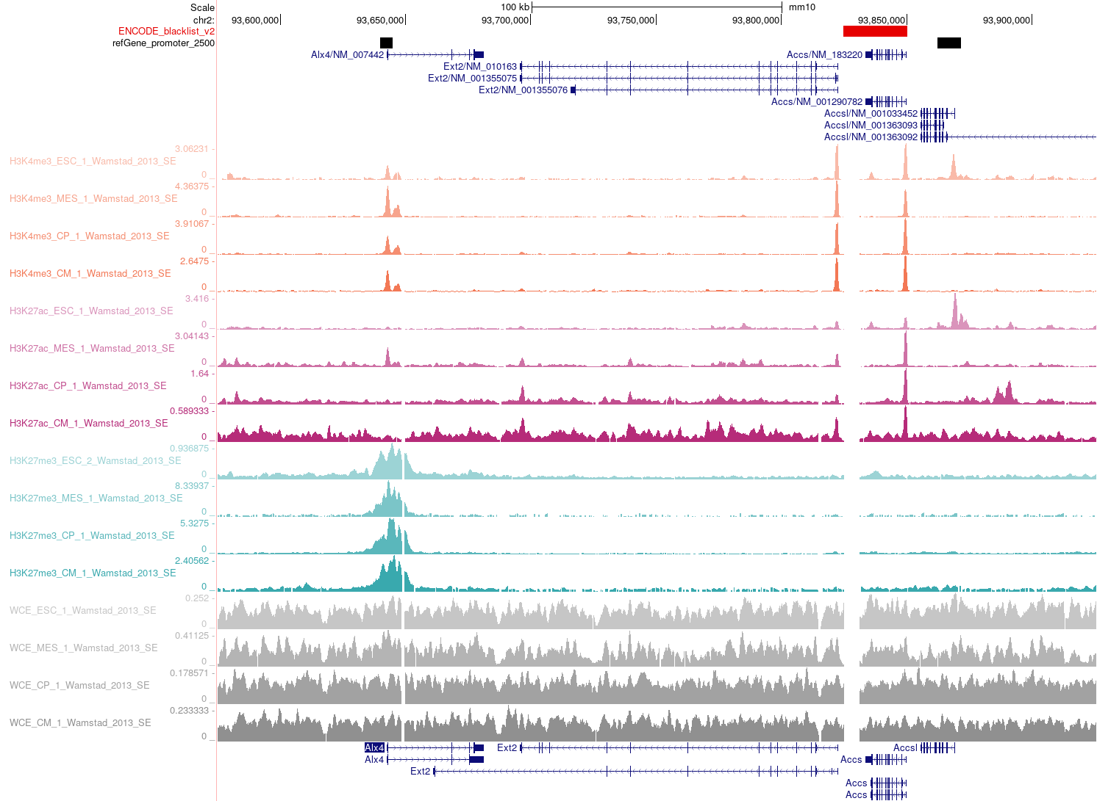
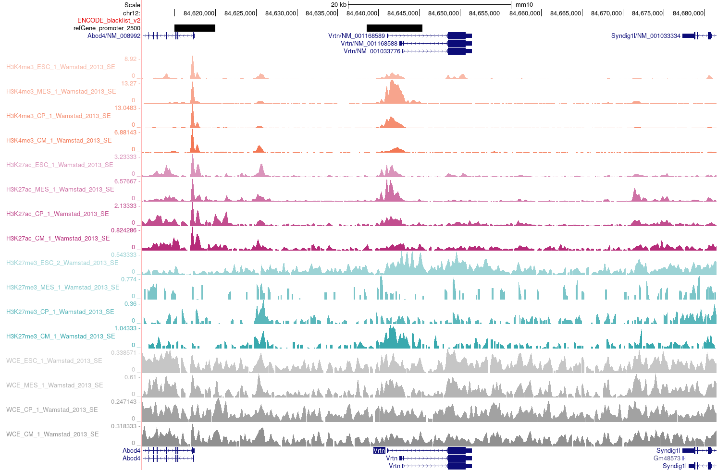
C48:Bivalent throughout the differentiation and expressed in mid-stages
Alx4
Vrtn*

Slide 59
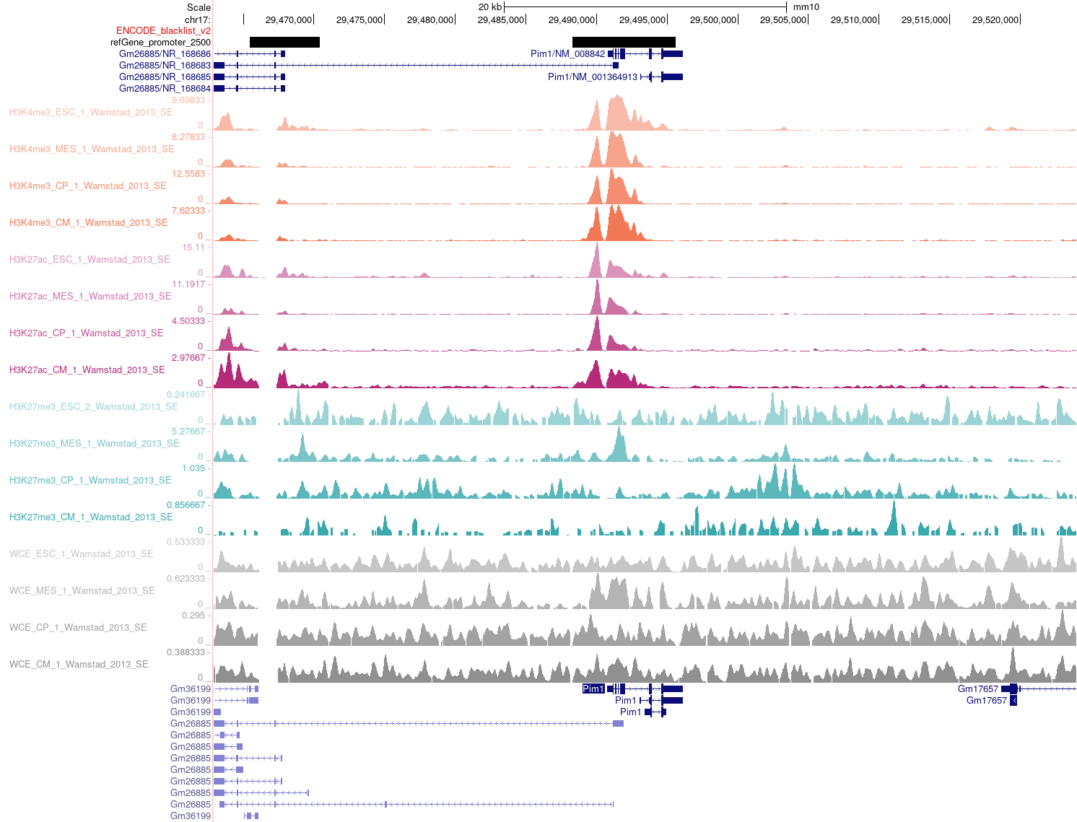
C51: Valley-like expression pattern, bivalent in mid-stages
Pim1

Slide 60
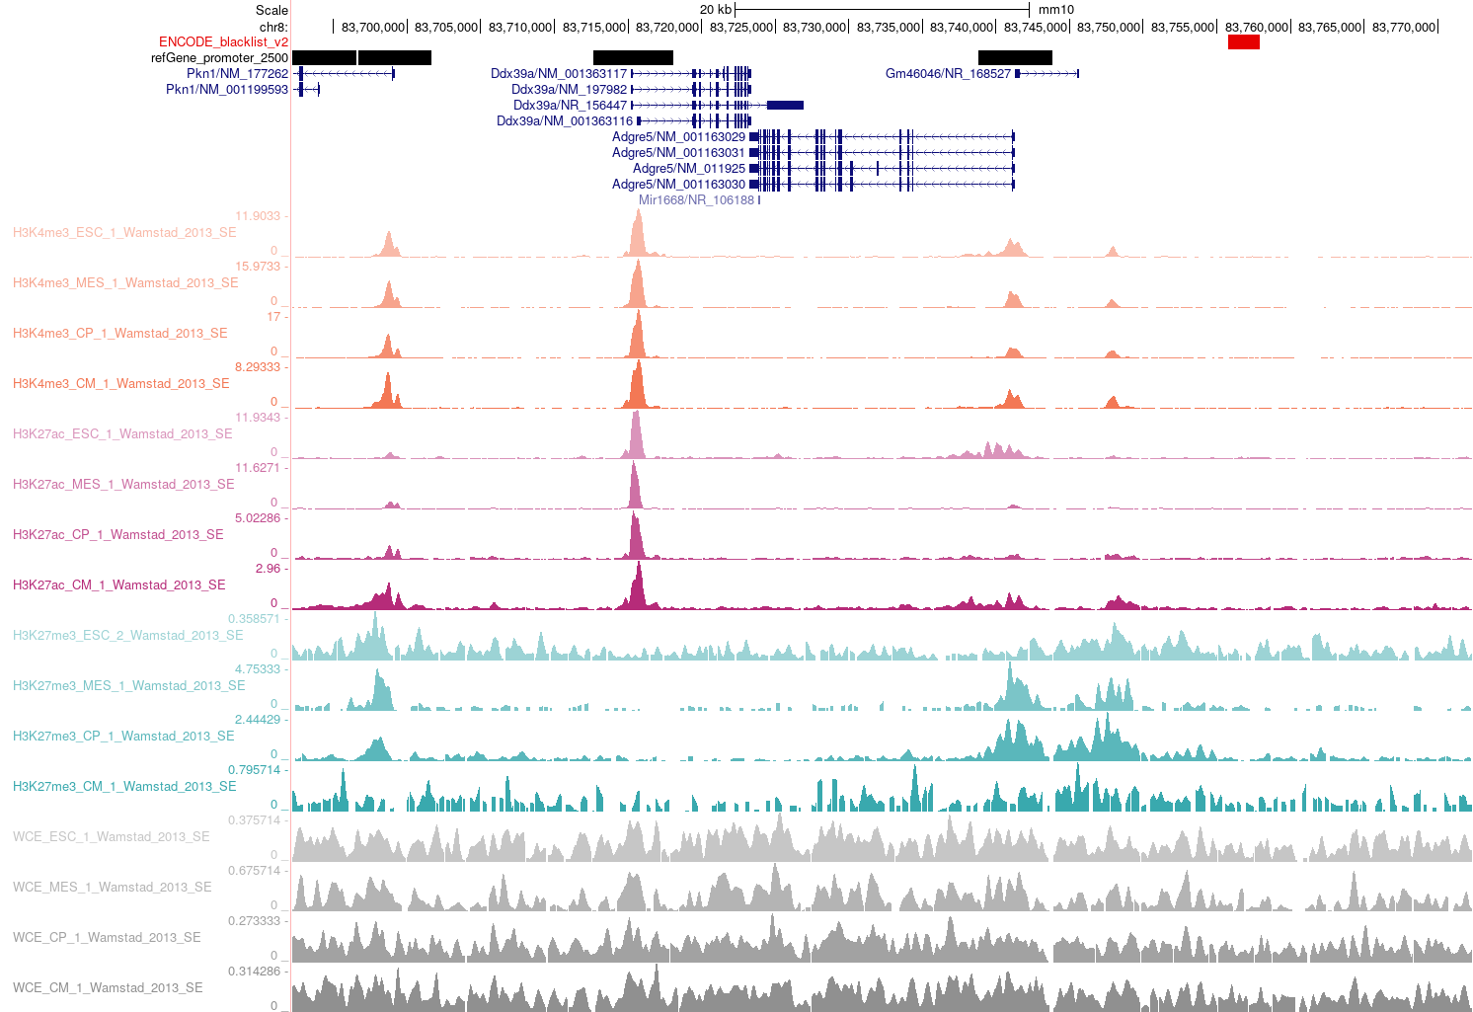
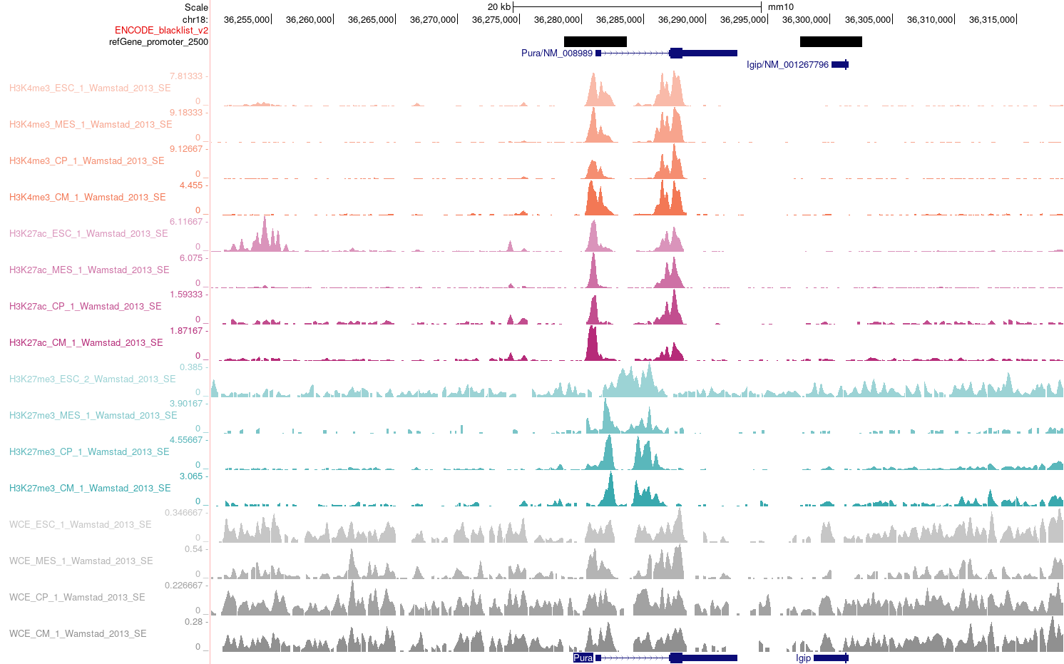
C51: Valley-like expression pattern, bivalent in mid-stages
Adgre5
Pura (Difficult to interpret)

